Slide 1
Default Report
2021 UBC Emeritus College Member Survey
June 6th 2021, 4:37 pm MDT

Slide 2
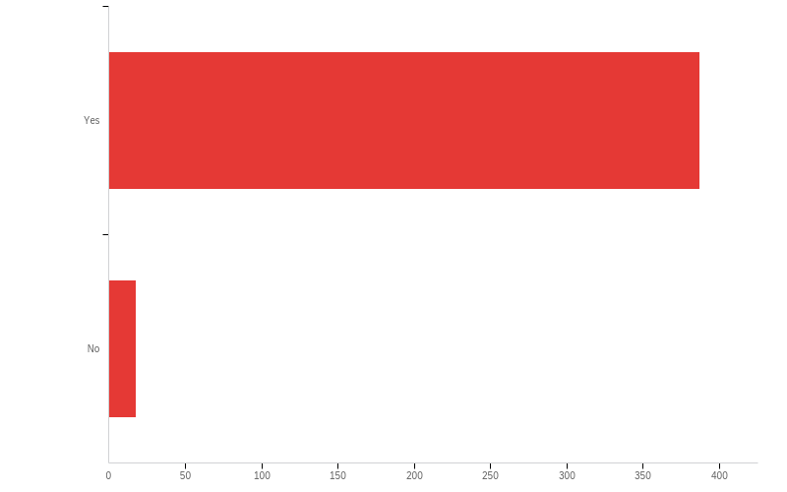
Q4 - Are you a UBC Senate-approved Emeritus/a faculty member?

Slide 3
Q4 - Are you a UBC Senate-approved Emeritus/a faculty member?
# | Field | Minimum | Maximum | Mean | Std Deviation | Variance | Count
1 | Are you a UBC Senate-approved Emeritus/a faculty member? | 1.00 | 2.00 | 1.04 | 0.21 | 0.04 | 405

Slide 4
Q4 - Are you a UBC Senate-approved Emeritus/a faculty member?
# | Answer | % | Count
1 | Yes | 95.56% | 387
2 | No | 4.44% | 18
 | Total | 100% | 405

Slide 5
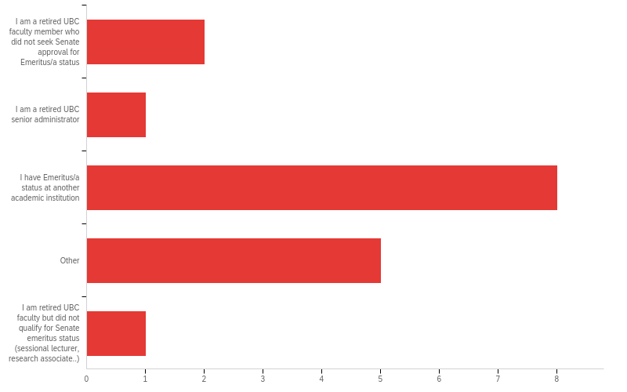
Q5 - Which of the following choices best describes your affiliation with the College?

Slide 6
Q5 - Which of the following choices best describes your affiliation with the College?
# | Field | Minimum | Maximum | Mean | Std Deviation | Variance | Count
1 | Which of the following choices best describes your affiliation with the College? - Selected Choice | 1.00 | 5.00 | 3.12 | 1.02 | 1.04 | 17

Slide 7
Q5 - Which of the following choices best describes your affiliation with the College?
# | Answer | % | Count
1 | I am a retired UBC faculty member who did not seek Senate approval for Emeritus/a status | 11.76% | 2
2 | I am a retired UBC senior administrator | 5.88% | 1
3 | I have Emeritus/a status at another academic institution | 47.06% | 8
4 | Other | 29.41% | 5
5 | I am retired UBC faculty but did not qualify for Senate emeritus status (sessional lecturer, research associate..) | 5.88% | 1

Slide 8
Q5 - Which of the following choices best describes your affiliation with the College?
# | Answer | % | Count
 | Total | 100% | 17

Slide 9
Q5 - Which of the following choices best describes your affiliation with the College?
Unable to export widget. Please contact Qualtrics Support.

Slide 10
Q6 - IDENTIFYING DATA
Unable to export widget. Please contact Qualtrics Support.

Slide 11
Q6 - IDENTIFYING DATA
A) Year of Birth | B) Year of Retirement | C) Department/School | D) Faculty
1936 | 2001 | Earh, Ocean and Atmospheric Sciences | Science
1944 | 2009 | Agroecology | Land & Food Systems
1942 | 2007 | Earth Ocean Atmospheric sciences | Science
1945 | 1975 | Dermatology | Medicine
1948 | 2015 | Art History, Visual Art and Theory | Arts
1934 | 2019 | Ophthalmology | Medicine
1936 | 2001 | Physics and Astronomy | Science
1938 | 2003 | Physics | Science
1939 | 1995 | anthropology | arts

Slide 12
Q6 - IDENTIFYING DATA
A) Year of Birth | B) Year of Retirement | C) Department/School | D) Faculty
1933 | 1995 | Physics and Astronomy | Science
october 4 1939 |  | School of Physical Education and Recreation | Education
1947 | 2015 | UBC | Urologic Sciences
1934 | 2000 | english | arts
1933 | 1998 | EOAS | Science
1941 | 1998 | Library
930 | 9 92 | English | ARTS
1940 | 2000 | Mathematics | Science
1937 | 2002 | Economics | Arts
1943 | 2007 | Mathematics | Science

Slide 13
Q6 - IDENTIFYING DATA
A) Year of Birth | B) Year of Retirement | C) Department/School | D) Faculty
1942 | 2007 | Hisyory | Arts
1944 | 2009 | French, Hispanic and Italian Studies | Arts
1942 | 2019 | Forest & Conservation Sciences | Forestry
1952 | 2019 |  | Pharmaceutical Sciences
1933 | 1998 | English | Arts
1938 | 2003 |  | Pharm Sciences
1943 | 2013 | Applied Science; Science | Mathematics, Mechanical Engineering
June 13,1931 | 1967 | English | Arts
1948 | 2015 |  | Phar Sci

Slide 14
Q6 - IDENTIFYING DATA
A) Year of Birth | B) Year of Retirement | C) Department/School | D) Faculty
1945 | 2012 | Mechanical Engineering | Applied Science
1936
1929 | 1991 (?) | Education Administration | Educatiion
1949 | 2019 | Hematology | Medicine
1936 | 1999 | Nursing | Applied Science
1950 | 2014 | Curriculum & Pedagogy | Education
1947 | 2016 | Medical Genetics | Medicine
1938 | 2003 | Institute of Asian Research | Arts
1945 | 2001 | Restorative Dentistry | Dentistry

Slide 15
Q6 - IDENTIFYING DATA
A) Year of Birth | B) Year of Retirement | C) Department/School | D) Faculty
1943 | 2015 | Physical Therapy | Medicine
1946 | 2015 | Language and Literacy Education | Education
1954 | 2018 | Pathology and Laboratory Medicine | Medicine
1934 | 1999 | English | Arts
1939 | 2005 | School of Creative Writing | Arts
1951 | 2018 |  | Faculty of Pharmaceutical Sciences
1952 | 2017 | Biochemistry & Molecular Biology | Medicine
1943 | 2011 | UBC | Medicine
1934 | 2000 | Electrical and Computer Engineering | Applied Science

Slide 16
Q6 - IDENTIFYING DATA
A) Year of Birth | B) Year of Retirement | C) Department/School | D) Faculty
1943 | 2018 | Oral Biological & Med. Sciences | Dentistry
1953 | 2008 | Library | Library
1951 | 2014 | Orthopaedics | Medicine
1946 | 2011 | Physics & Astronomy | Science
1937 | 2000 | Oral Medical Surgical Sciences | Dentistry
1939 | 1988 | English | Arts
1936 | 1991 | Human Kinetics | Education
1944 | 2014 | Educational Studies | Education
1953 | 2020 | Creative Studies | Creative and Critical Studies

Slide 17
Q6 - IDENTIFYING DATA
A) Year of Birth | B) Year of Retirement | C) Department/School | D) Faculty
1944 | 2007 | Nursing | Applied Science
1943 | 2013 | art history | arts
1945 | 1996 | Paediatrics | Faculty
1942 | 2011 | Political Science | Arts
1947 | 2004 | Koerner Library
1937 | 2002 | History | Arts
1939 | 2004 | EECE | APSC
1944 | 2011 | Radiology | Medicine
July 11, 1941 | 2001 | Physics and Astronomy | Science
1942 | 2010 | Curriculum and Pedagogy | Education

Slide 18
Q6 - IDENTIFYING DATA
A) Year of Birth | B) Year of Retirement | C) Department/School | D) Faculty
May 16 1942 | sept 1, 2018 | physics | Science
1936 | 2001 | Chemistry/UBC | Science
1941 | 2006 | History | Arts
1943 | 2018 | Medicine | Medicine
1941 | 2006 | CNERS | Arts
1941 | 2007 | Electrical and Computer Engineering | Applied Science
1931 | 1966 | Electrical and Computer Engineering | Applied Science
1946 | 2018 | Civil Engineering | Applied Science
1947 | 2020 |  | Land and Food Systems
1962 | 2019 | Materials Engineering | Applied Science

Slide 19
Q6 - IDENTIFYING DATA
A) Year of Birth | B) Year of Retirement | C) Department/School | D) Faculty
1947 | 2017 |  | Allard School of Law
1946 | 2012 | CNERS | Arts
1943 | 2016 | Psychology | Arts
1950 | 2015 | Computer Science | Science
1954 | 2020 | CPS | Medicine
1937 | 2002 | Psychology | Arts
1949 | 2020 | ECPS | Education
1946 | 2016 | Pathology and Laboratory Medicine | Medicine
1944 | 2013 | Political Science | Arts
1942 | 2007 | Earth, Ocean & Atmospheric Sciences | Science

Slide 20
Q6 - IDENTIFYING DATA
A) Year of Birth | B) Year of Retirement | C) Department/School | D) Faculty
1954 | 2016 | Food, Nutrition and Health | Land and Food Systems
1955 | 2019 | Oral Health Sciences | Dentistry
1932 | 1996 | Mathematics | Science
1945 | 2018 | Pediatrics | Medicine
1941 | 2004 |  | Sauder School of Business
1957 | 2020 | Biology | Arts and Science
1947 | Not retired | Psychiatry | Medicine
1938 | 2004 | Botany | Science
1941 | 2006 | Medical Genetics | Medicine
1951 | 2018 | School of Population & Public Health | Medicine

Slide 21
Q6 - IDENTIFYING DATA
A) Year of Birth | B) Year of Retirement | C) Department/School | D) Faculty
1954 | 2019 | CPS | Medicine
1943 | 2011 | History | Arts
1943 | 2009 | Forest Sciences | Forestry
1948 | 2015 | Educational Studies | Education
1936 | 1998 | Nursing | Applied Science
1950 | 2018 | Pediatrics | Medicine
1939 | 2010? | Kinesiology | Education
1931 | 2115 | Dermatology
1929 | 1995 | Medicine | Medicine
 | 2005 | Nursing | Applied Science
1942 | 2001 | Hispanic Italian | Arts

Slide 22
Q6 - IDENTIFYING DATA
A) Year of Birth | B) Year of Retirement | C) Department/School | D) Faculty
1942 | 2007 | Social Work | Arts
1934 | 1999 | Chemical and Biological Engineering | Applied Science
1955 | 2020 | Pathology | Medicine
1946 | 2007 | Curriculum & Pedagogy | Education
1952 | 2017 | Population & Public Health | Medicine
1941 | 2012 | Education/UBCO | Education
1948 | 2017 | School of Audiology and Speech Sciences | Medicine
1933 | 1999 | Forestry
1933 | 1995 | Physics and Astronomy | Science

Slide 23
Q6 - IDENTIFYING DATA
A) Year of Birth | B) Year of Retirement | C) Department/School | D) Faculty
1943 | 2005 | History | Arts
1932 | ? | Microbiology | Science
1938 | 2003 | Botany | Science
1934 | 1998 | Architecture | Grad Studies
1946 | 2019 | University of Toronto | Medicine
1929 | 1993 | Kinesiology | Education
1935 | 2017 | Orthopaedics | Medicine
1936 | 2002 | Medicine | Medicine
1946 | 2915 | Oral Health Science | Dentistry
1952 | 2020 | Electrical and Computer Engineering | Applied science

Slide 24
Q6 - IDENTIFYING DATA
A) Year of Birth | B) Year of Retirement | C) Department/School | D) Faculty
1942 | 2002 | Nursing | Applied Science
1946 | 2016 | computer science | science
1942 | 2012 |  | Forestry
1950 | 2019 | Occupational Sciences& Occupational Therapy | Medicine
1939 | 2004 | Sauder | Commerce & Bus Admin
1935 | 1998 | EOS | Science
1942 | 2015 | Philosophy | Arts
1949 | 2013 | TRIUMF, UBC | TRIUMF, UBC
1944 | 2012 | Zoology | Science
1937 | 2000 | Oral,Medical and Surgical Sciences | Dentistry

Slide 25
Q6 - IDENTIFYING DATA
A) Year of Birth | B) Year of Retirement | C) Department/School | D) Faculty
1956 | 2018 | Pharmaceutical Sciences | Pharmaceutical Sciences
1947 | 2017 | Geography | Arts
1941 | 2006 | Continuing Studies | Continuing Studies
1934 | 2028 | Ophthalmology | Medicine
1957 | 2012 | Asian Studies | Arts
1936 | 1997 | Radiology | Medicine
1941 | 1966 | Audiology & Speech Sciences | Medicine
1956 | 2018 | Pediatrics | Medicine
1954 | 2020 | Psychology | Arts and Social Science (UBCO)
1946 | 2016 | AHVAT | Arts (and GPDS)

Slide 26
Q6 - IDENTIFYING DATA
A) Year of Birth | B) Year of Retirement | C) Department/School | D) Faculty
1948 | 2016 | Physical Therapy | Medicine
1955 | 2020 | Population and Public Health | Medicine
1951 | 2008 | Population and Public Health | Medicine
1942 | 1977 |  | Sauder School
1941 | 1998 | Library | Librarian
1947 | 2014 | Ob gyn | Medicine
1946 | 2014 | Family Medicine | Schulich School of Medicine & Dentistry, Western University
1950 | 2015 | Psychiatry | Medicine
1931 | 1966 | Electrical and Computer Engineering | Applied Science

Slide 27
Q6 - IDENTIFYING DATA
A) Year of Birth | B) Year of Retirement | C) Department/School | D) Faculty
1932 | 1993 | Physiology | Medicine
1949 | 2014 | Civil Engineering | Applied Science
1941 | 2006 | Chemistry | Science
1939 | 2004 | EECE | APSC
1945 | 2018 | Family practice | Medicine
1931 | 1996 | Chemistry | Science
1926 | 1991 | Pathology | Medicine
1951 | 2016 | Radiology | Medicine
1943 | 2015 | Medicine | Ob/gyn
1946 | 2018 | Director, Wine Research Centre | Land and Food Systems
1952 | 2016 | Occupational Science & Occupational Therapy | Medicine

Slide 28
Q6 - IDENTIFYING DATA
A) Year of Birth | B) Year of Retirement | C) Department/School | D) Faculty
1950 | 2018 | Economics | Arts
1952 | 2017 | medicine | medicine
1941 | 2006 | English | Arts
1944 | 2007 | Asian Library | Library
1942 | 2012 | Sociology | IK Barber at UBCO
1957 | 2019 |  | Library
1927 | 1993 | Sociology | Arts
1945 | 2016 | Sauder School of Business | Strategy and Business Economics Division
1949 | 2019 | FHIS | Arts
1949 | 2019 | English | Arts

Slide 29
Q6 - IDENTIFYING DATA
A) Year of Birth | B) Year of Retirement | C) Department/School | D) Faculty
1940 | 2005 | Physics and Astronomy | Science
1951 | 2018 | UBC Library | Education Library
1936 | 2001 | Chemistry | Science
1935 | 2001 | Asian Studies | Arts
1931 | 2011 | Family Medicine | Mecicine
1933 | 1998 | EOAS | Science
1944 | 2013 | English | Arts
1951 | 2019 | Anthropology | Arts
1944 | 2019 | Kinesiology | Education
1954 | 2020 | Medicine | Medicine
1950 | 2015 | Microbiology & Immunology | Science

Slide 30
Q6 - IDENTIFYING DATA
A) Year of Birth | B) Year of Retirement | C) Department/School | D) Faculty
1945 | 2018 | Psychiatry/UBC
1934 | 1999 | English | Arts
1947 | 1919 | Joint Radiology Physics&Astronomy | Joint Medicine and Science
1944 | 2004 | Anthropology | Arts
1951 | 2019 | Creative Studies | FCCS
1940 | 2000 | Mathematics | Science
1945 | 2011 | Library | Library
1944 | 2012 | Population and Public Health | Medicine
1940 | 2005 | English | Arts
1950 | 2020 | Language and Literacy Education | Education

Slide 31
Q6 - IDENTIFYING DATA
A) Year of Birth | B) Year of Retirement | C) Department/School | D) Faculty
1943 | 1991 | Statistics | Science
1944 | 2007 | Asian Library | Library
1933 | 1998 | Chemistry | Science
1946 | 2020 | Anthropology | Arts
1948 | 2015 |  | Pharmaceutical Sciences
1942 | 2020 | N/A | Law
1952 | 2014 | Library | Library
1954 | 2018 | Medicine | Pathology and Laboratory Medicine
1956 | 2018 | Medicine | Pediatrics
1955 | 2020 | Oral Health Sciences | Dentistry

Slide 32
Q6 - IDENTIFYING DATA
A) Year of Birth | B) Year of Retirement | C) Department/School | D) Faculty
1939 | 2004 |  | Pharm. Sci.
1948 | 2013 | Occupational Therapy | Medicine
1978
1941 | 2003 | Law | Law
1935 | 1998 | Geological Sciences | Sience
1925 | 1&988 | Oral health | Dentistry
1932 | 1997 | Economics | Arts
 |  |  | Sauder
1945 | 2008 | Counselling Psychology | Education
1942 | 2004 | Zoology | Science

Slide 33
Q6 - IDENTIFYING DATA
A) Year of Birth | B) Year of Retirement | C) Department/School | D) Faculty
1942 | 2007 | Anesthesia/ Pharmacology & Therapeutics | Medicine
1941 | 2007 | Asian Studies | Arts
1932 | 1998 | Theatre/Film | Arts
1950 | 2014 | School of nursing okanagan | Associate professor
1944 | 2003 | Educational Studies | Education
1933 | 1999 | forestry | forest science
1932 | 1997 | Chemistry | Science
1933 | 1998 | EOAS | Science
1949 | 2020 | AHVA | Arts

Slide 34
Q6 - IDENTIFYING DATA
A) Year of Birth | B) Year of Retirement | C) Department/School | D) Faculty
11934 | 2019 |  | Medicine
1938 | 2003 | Botany | Science
1945 | 2012 | Library
1935 | 2001 | Asian Studies | Arts
1943 | 2014 | CHBE | APSC
1947 | 2020 | Surgery | Medicine
1946 | 2016 | Music | Arts
1941 | 2006 | Theatre | Arts
1951 | 2015 | Psychiatry | Medicine
1949 | 2014 | Chemistry | Science
1936 | 2001 | Curriculum & Pedagogy | Education

Slide 35
Q6 - IDENTIFYING DATA
A) Year of Birth | B) Year of Retirement | C) Department/School | D) Faculty
1947 | 2019 | Radiology | Medicine
1947 | 2014 | Nursing. | Applied Science
1944 | 2012 | English | Creative and Critical Studies
1947 | 2015 | Psychology | Arts
1940 | 2008 | SALA Arch | ASc
1946 | 2012 | Micb | Sci
1943 | 2009 | Forest Sciences | Forestry
1946 | 2018 | Computer Science | Science
1943 | 2016 | Arts/psychology | Arts
1945 | 2015 | Classical, NE and Religious Studies | Arts

Slide 36
Q6 - IDENTIFYING DATA
A) Year of Birth | B) Year of Retirement | C) Department/School | D) Faculty
1947 | 2002 | Plant Science | Land & Food Systems
1949 | 2020 | Mathematics | Science
1948 | 2017 | Pediatrics/Pathology | Medicine
1936 | 1990 | Hispanic and Italian Studies | Arts
1932 | 1993 | Physiology | Medicine
1941 | 2006 | History | Arts
1929 | 1995 | Medicine | Medicine
1932 | 1967 | psychology | arts
1942 | 2005 | Bioc & Mol Biol | Medicine
1945 | 2020 | Orthopaedics | Medicine

Slide 37
Q6 - IDENTIFYING DATA
A) Year of Birth | B) Year of Retirement | C) Department/School | D) Faculty
1947 | 2019 | ecps | Assoc.Prof Teaching
1955 | 2015 | Law | Law
1946 | 2016 | Geography | Arts
1935 | 2000 | Political Science | Arts
1956 | 2017 | Pathology | Medicine
1948 | 2017 | SCARP | Ap Sci
1927 | 1992 | Asian Studies | Arts
1946 | 2018 | Educational & Counseling Psychology & Special Education | education
1951 | 2016 | Occup Sc Occup Ther | Medicine

Slide 38
Q6 - IDENTIFYING DATA
A) Year of Birth | B) Year of Retirement | C) Department/School | D) Faculty
1941 | 2006 | Political Science | Arts
1947 | 2015 | Academic Performance Division | Continuing Studies
1929 | 1993 | Kinesiology | Education
1951 | 2016 | OHSC | Dentistry
1932 | 1997 | School of Human Kinetics | Education
1942 | 2003 | Nursing | Applied Science
1943 | 2008 | Rehab Sciences | Medicine
1950 | 2017 | Educational Studies | Education
1946 | 2020 | Orthopedics | Medicine
1947 | 2018 | History | Arts

Slide 39
Q6 - IDENTIFYING DATA
A) Year of Birth | B) Year of Retirement | C) Department/School | D) Faculty
1942 | 1997 | IRES and EarthOcean & Atmospheric Sciences | Grad Studies/Science
1956 | 20119 | Psychiatry | Medicine
1943 | 2013 | history | Arts
1948 | 2017 | OHSC | Dentistry
1935 | 1998 | Physics and Astronomy | Science
1951 | 2018 | UBC Library | Education Library
1944 | 2009 | Dept of Orthopaedics | Medicine
1944 | 2012 | Zoology | Science
1951 | 2018 |  | Faculty of Pharmaceutical Sciences

Slide 40
Q6 - IDENTIFYING DATA
A) Year of Birth | B) Year of Retirement | C) Department/School | D) Faculty
1946 | 2010 | Nursing | Applied science
1945 | 2013 | Anthropology | Arts & SCiences UBCO
15/04/1950 | 2020 | Occupational Therapy and Sciences | Medicine
1951 | 2014 | Orthopaedics | Medicine
1937 | 1999 | Geography Dept | Arts&Science
1940 | 2006 | Psychology | Arts
1954 | 2017 | Food Nutrition and Health | Land and Food Systems
1957 | 2020 | Biology | Arts and Sciences
1938 | 2003 | Botany | Science
1948 | 2018 | Engish | Arts

Slide 41
Q6 - IDENTIFYING DATA
A) Year of Birth | B) Year of Retirement | C) Department/School | D) Faculty
1933 | 1968 | EDST | Education
1939 | 2001 | kinesiology | education
1947 | 2016 | EDCP | Education
1940 | 2002 | Sauder
1939 | 2005 | Dept. Anesthesiology + Pharm. &Therapeutics | Medicine
1941 | 2006 | Orthopaedics | Medicine
1940 | 2005 | Psychology | Arts/Science
1944 | 2013 | English | Arts
1940 | 2011 | Civil Engineering/Registrar's Office/UBC IT | Applied Science

Slide 42
Q6 - IDENTIFYING DATA
A) Year of Birth | B) Year of Retirement | C) Department/School | D) Faculty
1938 | 2004 | Botany | Science
1942 | 2012 | CENES | ARTS
1939 | 2004 | Medicine | Pediatrics and Medical Genetics
1941 | 2006 | Botany | Science
1941 | 2007 | History | Arts
1936 | 2002 | Department of Medicine | Faculty of Medicine
1944 | 2010 | Social Work | Arts
1948 | 2016 | Department of Wood Science | Faculty of Forestry
1944 | 2009 | Paediatrics | Medicine
1947 | 2020 | Medicine | Medicine

Slide 43
Q6 - IDENTIFYING DATA
A) Year of Birth | B) Year of Retirement | C) Department/School | D) Faculty
1949 | 2020 | Sociology | Arts
1941 | 2007 | Electrical and Computer Engineering | Applied Science and Engineering
1950 | 2014 | Creative Studies | Creative & Critical Studies
1939 | 2004 | EDST | Education
1944 | 2006 | Rehabilitation | Medicine
1951 | 2015 | Art Education | Education
1939 | 2004 |  | Sauder
1949 | 2019 | Botany | Science
1931 | 1996 | Mechanical Engineering | Applied Science
1953 | 2018 | Sauder School of Business | Sauder School of Business

Slide 44
Q6 - IDENTIFYING DATA
A) Year of Birth | B) Year of Retirement | C) Department/School | D) Faculty
1038 | 2003 | Institute of Asian Research | Arts
1941 | 2006 | Community and Regional Planning
1942 | 1977 | Operations and Logistics | Sauder Business School
1942 | 2010 | History | Arts
1953 | 2017 | Creative Writing Program (now School of) | Arts
1934 | 1995 | nursing | applied science
1951 | 2019 | Pediatrics | Medicine
1946 | 2016
1944 | 2008 | English | Arts

Slide 45
Q6 - IDENTIFYING DATA
A) Year of Birth | B) Year of Retirement | C) Department/School | D) Faculty
1945 | 2011 | Language and Literacy Education | Education
1949 | 2013 | Botany/Zoology | Science
1944 | 2012 | Paediatrics | Medicine
1952 | 2017 | Biochemistry and molecular biology | Medicine
1944 | 2014 | EDST | Education
1946 | 2014 | Pathology and Laboratory Medicine | Medicine
1937 | 2000 | Mathematics | Science
1943 | 2008 | Pediatrics | Medicine
1945 | 2014 | Medicine/Neurology | Medicine
1952 | 2019 | Family Medicine | Medicine

Slide 46
Q6 - IDENTIFYING DATA
A) Year of Birth | B) Year of Retirement | C) Department/School | D) Faculty
1941 | 2007 | French/Women’s Sts | Arts
1942 | 2014 | ECPS | Education
1944 | 2009 | English | Arts
1951 | 2011 from UBC | Paediatrics | Medicine
1938 | 2003 | Cardiac Surgery | Medicine
1943 | 2016 | Language & Literacy Education (LLED) | Education
1936 | 1998 |  | Commerce
1927 | 1993 | Sociology | Arts
1946 | 2013 | Counselling Psychology | Education
1947 | 2003

Slide 47
Q6 - IDENTIFYING DATA
A) Year of Birth | B) Year of Retirement | C) Department/School | D) Faculty
1955 | 2020 | School of Population and Public Health | Medicine
1942 | 2010 | Applied Ethics/SPPH | Medicine
1945 | 2011 | Microbiology and Immunology | Science
1949 | 2019 | Obstet Gynec Cumming School of Medicine | Medicine
1951 | 2018 | School of Population & Public Health | Medicine
1943 | 2013 | Nursing/Psychology | Health Sciences/Arts & Science
1950 | 2019 | Statistics | Science

Slide 48
Q6 - IDENTIFYING DATA
A) Year of Birth | B) Year of Retirement | C) Department/School | D) Faculty
1946 | 2016 | Law | Law
1934 | 1999 | Earth & Ocean Science | Science
1957 | 2018 | Ob/Gyn | Medicine
1943 | 2015 | Medicine | OB/GYN
1952 | 2017 | Population & Public Health | Medicine
1946 | 2019 | kinesiology/sports medicine | education/medicine
1939 | 2005 | Statistics | Science
1942 | 2017 | CCGS | Irving K. Barber School of Arts and Social Science
1943 | 2014 | math | science

Slide 49
Q6 - IDENTIFYING DATA
A) Year of Birth | B) Year of Retirement | C) Department/School | D) Faculty
1950 | 2017 | Geography | Arts
1946 | 2020 | School of Kinesiology | Education
1945 | 2010 | CENES | Arts
1946 |  | English | Arts
1943 | 2011 | History | Arts
1944 | 2004 | Political Science | Arts
1956 | 2020 | Medicine | Pediatrics
1932 | 1998 | Anthropology (formerly Anth & Sociology) | Arts
1940 | 2018 | Rheumatology | Medicine
1948 | 2020 | Political Science | Arts

Slide 50
Q6 - IDENTIFYING DATA
A) Year of Birth | B) Year of Retirement | C) Department/School | D) Faculty
1939 | 2005 ? | HKin | Education
1941 | 1996 | Pathology | Medicine
1940 | 2005 | Pediatrics | Medicine
1939 | 2004 | EECE | APSC
1952 | 2018 | Nursing | Applied Science
1950 | 2020 | Language and Literacy Education | Education
1954 | 2020 | Psychology | Arts & Social Science - UBCO
1944 | 2001 | Library | Library
1951 | 2018 | Okanagan School of Education | Education
1945 | 2011 | Library

Slide 51
Q6 - IDENTIFYING DATA
A) Year of Birth | B) Year of Retirement | C) Department/School | D) Faculty
1933 | 1998 | English | Arts
1955 | 2018 | Linguistics | Arts
1950 | 2018 | Psychology | Arts
1954 | 2018 | Psychology | Arts
1949 | 2016 | Computer Science | Science
1926 | 1991 | Pathology | Medicine
1940 | 2000 |  | Medicine
1934 | 1999 | English | Arts
1944 | 2010 | Political Science | Arts
1949 | 2018 | Art History and Visual Art | Arts
1953 | 2016 | EOAS | Science

Slide 52
Q6 - IDENTIFYING DATA
A) Year of Birth | B) Year of Retirement | C) Department/School | D) Faculty
1942 | 2003 | Chemistry | Science
1946 | 2014 | Schulich School of Medicine & Dentistry | Western University
1940 | 2001 |  | arts
1947 | 2018 | Kinesiology | Education
1942 | 2007 | Physics | science
1943 | 1999 | Cont studies/President’s office | N/a
1944 | 2002 | Food, Nutrition and Health | Land and Food Sustems
1936 | 1997 | Department of Radiology | Faculty of Medicine
1948 | 2008 | Physical Therapy | Medicine

Slide 53
Q6 - IDENTIFYING DATA
A) Year of Birth | B) Year of Retirement | C) Department/School | D) Faculty
1939 | 2004 | Geography | Arts
1938 | 2000 | Family Practice | Medicine
1937 | 2002 | Psychology | Arts
1931 | 1996 | Electrical and Computer Engineering | Applied Science
1937 | 2002 | History | Arts
1944 | 2016 | History and Sociology | Irving K. Barber Faculty of Arts & Social Sciences
1938 | 1998 | Psychology | Arts
1947 | 2012 | UBC Press | VP Research
1949 | 2019 | Obstetrics & Gynaecology | Medicine

Slide 54
Q6 - IDENTIFYING DATA
A) Year of Birth | B) Year of Retirement | C) Department/School | D) Faculty
1949 | 2014 | CNERS | Arts
1945 | 2016 | Asian Studies | Arts
1950 | 2018 | Vancouver School of Economics | Arts
1947 | 2013 | Women's Studies/Educational Studies | Arts/Education
1949 | 2014 | Law | Law

Slide 55
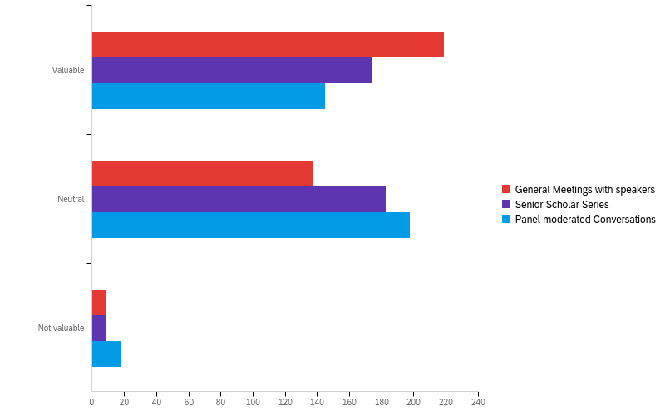
Q8 - Please rate the overall value to you of the following Programs that are offered.

Slide 56
Q8 - Please rate the overall value to you of the following Programs that are offered.
# | Field | Minimum | Maximum | Mean | Std Deviation | Variance | Count
1 | General Meetings with speakers | 1.00 | 3.00 | 1.43 | 0.54 | 0.29 | 366
2 | Senior Scholar Series | 1.00 | 3.00 | 1.55 | 0.54 | 0.30 | 366
3 | Panel moderated Conversations | 1.00 | 3.00 | 1.65 | 0.57 | 0.33 | 361

Slide 57
Q8 - Please rate the overall value to you of the following Programs that are offered.
# | Question | Valuable |  | Neutral |  | Not valuable |  | Total
1 | General Meetings with speakers | 59.84% | 219 | 37.70% | 138 | 2.46% | 9 | 366
2 | Senior Scholar Series | 47.54% | 174 | 50.00% | 183 | 2.46% | 9 | 366
3 | Panel moderated Conversations | 40.17% | 145 | 54.85% | 198 | 4.99% | 18 | 361

Slide 58
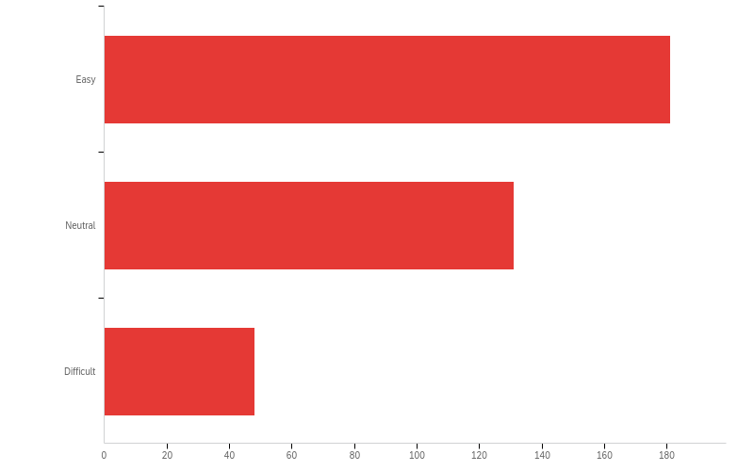
Q20 - As the COVID pandemic has limited our ability to socialize and meet in-person the College has switched to using ZOOM for meetings and webinar presentations. Which of the following answers describes your degree of success and comfort in making this switch for College activities?

Slide 59
Q20 - As the COVID pandemic has limited our ability to socialize and meet in-person the College has switched to using ZOOM for meetings and webinar presentations. Which of the following answers describes your degree of success and comfort in making this switch for College activities?
# | Field | Minimum | Maximum | Mean | Std Deviation | Variance | Count
1 | As the COVID pandemic has limited our ability to socialize and meet in-person the College has switched to using ZOOM for meetings and webinar presentations. Which of the following answers describes your degree of success and comfort in making this switch for College activities? | 1.00 | 3.00 | 1.63 | 0.71 | 0.50 | 360

Slide 60
Q20 - As the COVID pandemic has limited our ability to socialize and meet in-person the College has switched to using ZOOM for meetings and webinar presentations. Which of the following answers describes your degree of success and comfort in making this switch for College activities?
# | Answer | % | Count
1 | Easy | 50.28% | 181
2 | Neutral | 36.39% | 131
3 | Difficult | 13.33% | 48
 | Total | 100% | 360

Slide 61
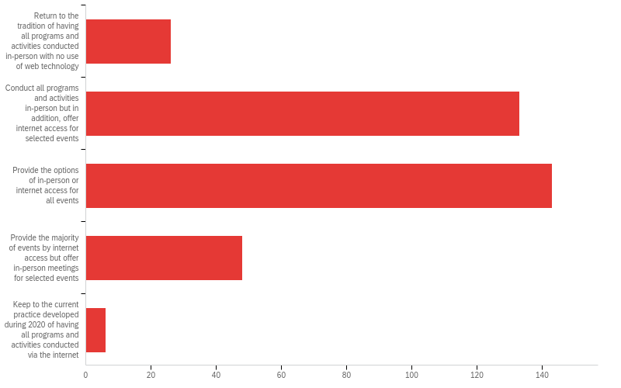
Q22 - When COVID no longer restricts our ability to socialize and meet in-person, the College will have to decide how to deliver its programs and activities. What would be your preference?

Slide 62
Q22 - When COVID no longer restricts our ability to socialize and meet in-person, the College will have to decide how to deliver its programs and activities. What would be your preference?
# | Field | Minimum | Maximum | Mean | Std Deviation | Variance | Count
1 | When COVID no longer restricts our ability to socialize and meet in-person, the College will have to decide how to deliver its programs and activities. What would be your preference? | 1.00 | 5.00 | 2.65 | 0.86 | 0.74 | 356

Slide 63
Q22 - When COVID no longer restricts our ability to socialize and meet in-person, the College will have to decide how to deliver its programs and activities. What would be your preference?
# | Answer | % | Count
1 | Return to the tradition of having all programs and activities conducted in-person with no use of web technology | 7.30% | 26
2 | Conduct all programs and activities in-person but in addition, offer internet access for selected events | 37.36% | 133
3 | Provide the options of in-person or internet access for all events | 40.17% | 143
4 | Provide the majority of events by internet access but offer in-person meetings for selected events | 13.48% | 48

Slide 64
Q22 - When COVID no longer restricts our ability to socialize and meet in-person, the College will have to decide how to deliver its programs and activities. What would be your preference?
# | Answer | % | Count
5 | Keep to the current practice developed during 2020 of having all programs and activities conducted via the internet | 1.69% | 6
 | Total | 100% | 356

Slide 65
Q13 - Is there other content that you would like to see in the Newsletter (or see more of):
Is there other content that you would like to see in the Newsletter (or see more of):
novel teaching/education activities
emeritus casual meetings, with special reference to coffee & light eating
Pesidential and Dean engagements
News about members and their post-retirement activities
The content of the Newsletter is quite copious already.
news about the campus and campus services
AARP, CARP highlights
nil
More information relevant to the Okanagan.
No
No, you are doing a great job!

Slide 66
Q13 - Is there other content that you would like to see in the Newsletter (or see more of):
Is there other content that you would like to see in the Newsletter (or see more of):
First-person stories of transition from academia to civilian life.
would like more discussion of issues/solutions connected to doing research post-retirement
selected opportunities from other university Colleges of Emeritus Professors
no
W
Items that would dispel wrong impressions about countries/areas outside U.S.A. and Canada
Profiles and perhaps photos of emeritae/i
Birding
No
Even though my commitments have prevented most participation in Emeritus activities to date, I expect this will change late 2022 onwards No, I find it informative and interesting

Slide 67
Q13 - Is there other content that you would like to see in the Newsletter (or see more of):
Is there other content that you would like to see in the Newsletter (or see more of):
One short recollection of an Emeritus/a in each newsletter. Like a 2 minute short from Herbert's legacy project.
Not at this time
Informative, short articles, based on the latest research on matters related to health. L|OVE the photography--provides an opportunity to stop and reflect.
I think it is just great the way it is.
Genealogy
More info appropriate to the Okanagan. The Vancouver stuff is not useful to me.
I had to say this, as I'm the Editor!
Short essays on thought provoking topics
the focus on Vancouver makes it difficult for Emeritus who live elsewhere
restaurant reviews would be nice

Slide 68
Q13 - Is there other content that you would like to see in the Newsletter (or see more of):
Is there other content that you would like to see in the Newsletter (or see more of):
thoughts of members on how we can make the world less difficult for marginalized people, such as people in prisons
Some recognition that some of us are located overseas and so can't be physically present, for example by making talks available through recording (if/as possible).
info about work of Profs Emerit who are still teaching/researching
Newsletter is excellent
The art show was fun!
I’d like to hear more stories from folks who retired outside of Greater Vancouver - many interesting experiences to share
Conversaziones
Z
Articles of general interest written by retired scholars

Slide 69
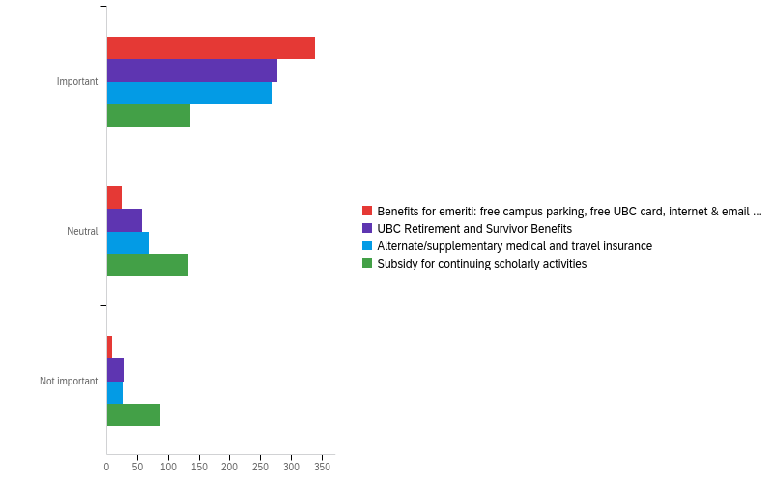
Q14 - The College continues the work of the Association of Professors Emeriti (APE) to advocate for emeriti and retirees. How important to you are the following?

Slide 70
Q14 - The College continues the work of the Association of Professors Emeriti (APE) to advocate for emeriti and retirees. How important to you are the following?
# | Field | Minimum | Maximum | Mean | Std Deviation | Variance | Count
1 | Benefits for emeriti: free campus parking, free UBC card, internet & email services | 1.00 | 3.00 | 1.11 | 0.39 | 0.15 | 372
2 | UBC Retirement and Survivor Benefits | 1.00 | 3.00 | 1.31 | 0.61 | 0.37 | 363
3 | Alternate/supplementary medical and travel insurance | 1.00 | 3.00 | 1.33 | 0.60 | 0.36 | 364
4 | Subsidy for continuing scholarly activities | 1.00 | 3.00 | 1.86 | 0.78 | 0.61 | 356

Slide 71
Q14 - The College continues the work of the Association of Professors Emeriti (APE) to advocate for emeriti and retirees. How important to you are the following?
# | Question | Important |  | Neutral |  | Not important |  | Total
1 | Benefits for emeriti: free campus parking, free UBC card, internet & email services | 91.13% | 339 | 6.45% | 24 | 2.42% | 9 | 372
2 | UBC Retirement and Survivor Benefits | 76.58% | 278 | 15.70% | 57 | 7.71% | 28 | 363
3 | Alternate/supplementary medical and travel insurance | 74.18% | 270 | 18.68% | 68 | 7.14% | 26 | 364
4 | Subsidy for continuing scholarly activities | 38.20% | 136 | 37.36% | 133 | 24.44% | 87 | 356

Slide 72
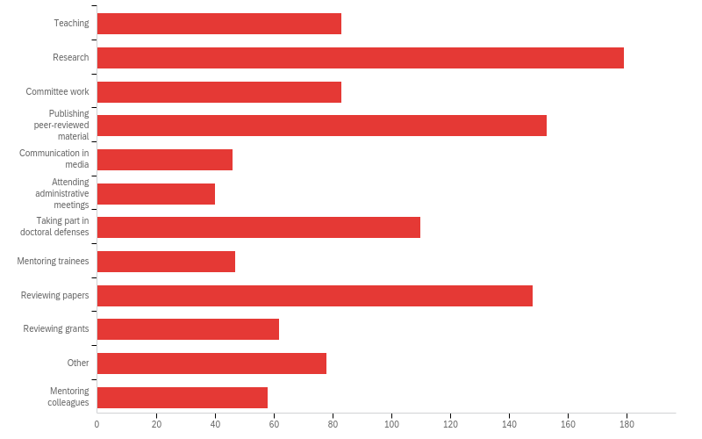
Q16 - Since retirement what are some of the professional activities you continue to participate in?Check all that apply.

Slide 73
Q16 - Since retirement what are some of the professional activities you continue to participate in?Check all that apply.
# | Answer | % | Count
1 | Teaching | 7.64% | 83
2 | Research | 16.47% | 179
3 | Committee work | 7.64% | 83
4 | Publishing peer-reviewed material | 14.08% | 153
5 | Communication in media | 4.23% | 46
6 | Attending administrative meetings | 3.68% | 40
7 | Taking part in doctoral defenses | 10.12% | 110
8 | Mentoring trainees | 4.32% | 47
9 | Reviewing papers | 13.62% | 148

Slide 74
Q16 - Since retirement what are some of the professional activities you continue to participate in?Check all that apply.
# | Answer | % | Count
10 | Reviewing grants | 5.70% | 62
11 | Other | 7.18% | 78
12 | Mentoring colleagues | 5.34% | 58
 | Total | 100% | 1087

Slide 75
Q16 - Since retirement what are some of the professional activities you continue to participate in?Check all that apply.
Unable to export widget. Please contact Qualtrics Support.

Slide 76
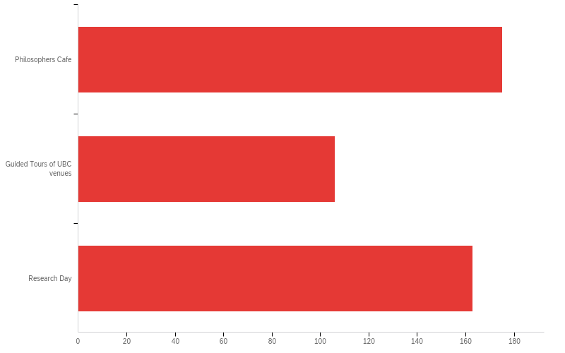
Q09 - Please indicate the College activities you would like to see resume after pandemic restrictions are lifted. Check all that apply.

Slide 77
Q09 - Please indicate the College activities you would like to see resume after pandemic restrictions are lifted. Check all that apply.
# | Answer | % | Count
1 | Philosophers Cafe | 39.41% | 175
4 | Guided Tours of UBC venues | 23.87% | 106
8 | Research Day | 36.71% | 163
 | Total | 100% | 444

Slide 78
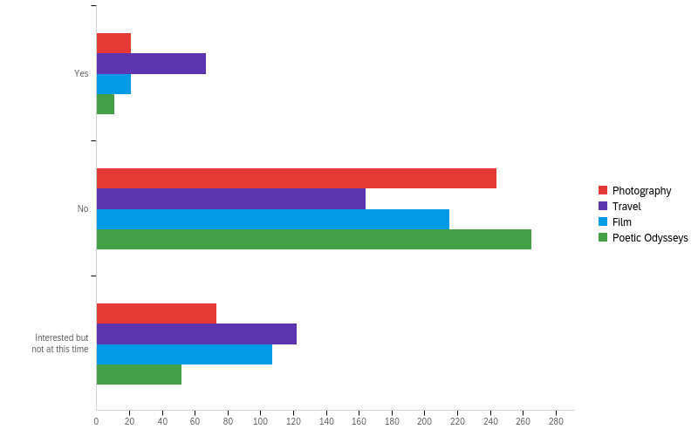
Q10 - Are you participating in the Special Interest Groups?

Slide 79
Q10 - Are you participating in the Special Interest Groups?
# | Field | Minimum | Maximum | Mean | Std Deviation | Variance | Count
1 | Photography | 5.00 | 7.00 | 6.15 | 0.50 | 0.25 | 338
2 | Travel | 5.00 | 7.00 | 6.16 | 0.71 | 0.51 | 353
3 | Film | 5.00 | 7.00 | 6.25 | 0.56 | 0.31 | 343
4 | Poetic Odysseys | 5.00 | 7.00 | 6.13 | 0.42 | 0.18 | 328

Slide 80
Q10 - Are you participating in the Special Interest Groups?
# | Question | Yes |  | No |  | Interested but not at this time |  | Total
1 | Photography | 6.21% | 21 | 72.19% | 244 | 21.60% | 73 | 338
2 | Travel | 18.98% | 67 | 46.46% | 164 | 34.56% | 122 | 353
3 | Film | 6.12% | 21 | 62.68% | 215 | 31.20% | 107 | 343
4 | Poetic Odysseys | 3.35% | 11 | 80.79% | 265 | 15.85% | 52 | 328

Slide 81
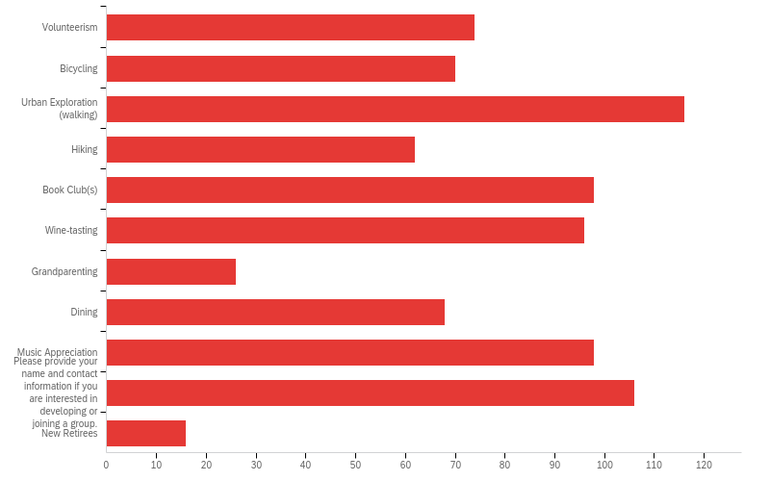
Q11 - Two more Special Interest Groups are primed to begin in 2021 -- Volunteerism and Easy Riders-bicycling. We are keen to establish additional groups and the possibilities are almost endless. Please indicate any of the following that you might find of interest and suggest others we have not thought about.

Slide 82
Q11 - Two more Special Interest Groups are primed to begin in 2021 -- Volunteerism and Easy Riders-bicycling. We are keen to establish additional groups and the possibilities are almost endless. Please indicate any of the following that you might find of interest and suggest others we have not thought about.
# | Answer | % | Count
1 | Volunteerism | 8.92% | 74
2 | Bicycling | 8.43% | 70
3 | Urban Exploration (walking) | 13.98% | 116
4 | Hiking | 7.47% | 62
5 | Book Club(s) | 11.81% | 98
6 | Wine-tasting | 11.57% | 96
7 | Grandparenting | 3.13% | 26
8 | Dining | 8.19% | 68
9 | Music Appreciation | 11.81% | 98
11 | Please provide your name and contact information if you are interested in developing or joining a group. | 12.77% | 106

Slide 83
Q11 - Two more Special Interest Groups are primed to begin in 2021 -- Volunteerism and Easy Riders-bicycling. We are keen to establish additional groups and the possibilities are almost endless. Please indicate any of the following that you might find of interest and suggest others we have not thought about.
# | Answer | % | Count
12 | New Retirees | 1.93% | 16
 | Total | 100% | 830

Slide 84
Q11 - Two more Special Interest Groups are primed to begin in 2021 -- Volunteerism and Easy Riders-bicycling. We are keen to establish additional groups and the possibilities are almost endless. Please indicate any of the following that you might find of interest and suggest others we have not thought about.
Q11_11_TEXT - Please provide your name and contact information if you are interested in d...
Please provide your name and contact information if you are interested in developing or joining a group. - Text
tredwell@me.com
tony bai
patricia merivale
marcia boyd marcia@roicorp.com
joanne.naslund@ubc.ca
hans.schuetze@ubc.ca
doug.wilson@ahs.ca
Yoshikata Koga
Would love to have things inclusive of the Okanagan campus
Wolfgang Linden wlinden@psych.ubc.ca
Volunteerism is already part of my life--Metro Van Food Bank, and since March/20, BC-CDC advising on lockdowns in BC and data analysis.This ended April 30th, 2021.I used to run several wine tasting events, on campus, when the old Faculty Club still existed. I am still a 'minor' collector, but nothing formal==age limits. Don Mavinic

Slide 85
Q11 - Two more Special Interest Groups are primed to begin in 2021 -- Volunteerism and Easy Riders-bicycling. We are keen to establish additional groups and the possibilities are almost endless. Please indicate any of the following that you might find of interest and suggest others we have not thought about.
Q11_11_TEXT - Please provide your name and contact information if you are interested in d...
Please provide your name and contact information if you are interested in developing or joining a group. - Text
Vijay Verma
Valerie White 604-818-9089 What about art appreciation? I know nothing structured about art.
Tony Dawson dawson@mail.ubc.ca
Tim McDaniels timmcd@mail.ubc.ca
These are all great ideas. Unfortunately I no longer live in Vancouver area and therefore unable to take advantage of wonderful programs offered.
T. Grigliatti grigliat@zoology.ubc.ca
Sue Stanton: Interested in volunteerism and a book club but do not expect to be able to consider participating before fall 2022, and will follow up then
Steve Savitt savitt01@gmail.com
Stan Lubin Stanlubin1@gmail.com 604-808-2448
Sorry, I will be 92 next month and am, sadly, no longer to participate in much.

Slide 86
Q11 - Two more Special Interest Groups are primed to begin in 2021 -- Volunteerism and Easy Riders-bicycling. We are keen to establish additional groups and the possibilities are almost endless. Please indicate any of the following that you might find of interest and suggest others we have not thought about.
Q11_11_TEXT - Please provide your name and contact information if you are interested in d...
Please provide your name and contact information if you are interested in developing or joining a group. - Text
Shauna Butterwick shaunab@mail.ubc.ca
Ross MacGillivray 604-228-0703
Robert DeWreede dewreede@mail.ubc.ca
Robert Adams adms@math.ubc.ca
Richard Johnston richard.johnston@ubc.ca
R.G. Matson rgmatson@shaw.ca
Peter Quartermain quarterm@mail.ubc.ca
Peter Moogk moogk@mail.ubc.ca
Peter Dodek peter.dodek@ubc.ca -interested in possibly joining one of these groups.
Olav Slaymaker
Nichola Hall ranhall@telus.net

Slide 87
Q11 - Two more Special Interest Groups are primed to begin in 2021 -- Volunteerism and Easy Riders-bicycling. We are keen to establish additional groups and the possibilities are almost endless. Please indicate any of the following that you might find of interest and suggest others we have not thought about.
Q11_11_TEXT - Please provide your name and contact information if you are interested in d...
Please provide your name and contact information if you are interested in developing or joining a group. - Text
Multiple choice exams are limiting. I live on Quadra Island and can't participate in any on-campus events. Lee Gass, lee@leegass.com
Mo Iqbal iqbal@mail.ubc.ca
Mike Healey healey@mail.ubc.ca
Michael Klein mklein@mail.ubc.ca
Michael Goldberg, 604-603-9797
Mel Comisarow melcom@chem.ubc.ca
Matthew Hartman matthartma@gmail.com
Matthew Hartman matthartma@gmail.com
Mark Thompson mrkthompson39@gmail.com
Marilyn Chapman marilyn.chapman@mac.com
Many of these Special Interest Groups would interest me but I live in Greece and my involvement is basically virtual.

Slide 88
Q11 - Two more Special Interest Groups are primed to begin in 2021 -- Volunteerism and Easy Riders-bicycling. We are keen to establish additional groups and the possibilities are almost endless. Please indicate any of the following that you might find of interest and suggest others we have not thought about.
Q11_11_TEXT - Please provide your name and contact information if you are interested in d...
Please provide your name and contact information if you are interested in developing or joining a group. - Text
Mahesh Upadhyaya Upadh@mail.ubc.ca
Linda Siegel linda.siegel@ubc.ca
Lee Johnson lee.johnson@ubc.ca
Larry Burr LHBurr@telus.net
Ken Brown kenneth.brown@ubc.ca Land (604)261-5350 Cell (604)779-5411
Julyet Benbasat Jbenbasat@yahoo.ca
Jolie Mayer-Smith jolie.mayer-smith@ubc.ca
John Richards eyedoc@telus.net
John Richards Eyedoc@telus.net
John McNeill 604 2245456
John J. Mitchell jnjmitchell65@gmail.com

Slide 89
Q11 - Two more Special Interest Groups are primed to begin in 2021 -- Volunteerism and Easy Riders-bicycling. We are keen to establish additional groups and the possibilities are almost endless. Please indicate any of the following that you might find of interest and suggest others we have not thought about.
Q11_11_TEXT - Please provide your name and contact information if you are interested in d...
Please provide your name and contact information if you are interested in developing or joining a group. - Text
John Challis 6042308398
John Aldrich
Jo-Anne Naslund joanne.naslund@ubc.ca
Jesse Read
Isabel Dyck isabel.lowe2012@gmail,com
I cannot do this at this time due to health issues at home.
I am still adjusting to my retirement...may be later
I am not well enough at the moment to make any committments
Health and wellness when I am less academically engaged in this area
George Egerton gegerton@mail.ubc.ca 778-886-4045
George Bluman bluman@math.ubc.ca

Slide 90
Q11 - Two more Special Interest Groups are primed to begin in 2021 -- Volunteerism and Easy Riders-bicycling. We are keen to establish additional groups and the possibilities are almost endless. Please indicate any of the following that you might find of interest and suggest others we have not thought about.
Q11_11_TEXT - Please provide your name and contact information if you are interested in d...
Please provide your name and contact information if you are interested in developing or joining a group. - Text
Gary Kinney kinneygary@shaw.ca
Gary Gibson gbgibson@telus.net
Gail Wilson gail.wilson@ubc.ca
Fred Brauer brauer@math.ubc.ca
Financial planning (including tax planning), wills, estate planning (including legacy giving)
F Alex Carre
F Alex Carre
Elizabeth Jordan 778-772-0285
Educational Outreach (i) for Elementary and High Schools; and (ii) for Seniors Niamh Kelly niamh.kelly@ubc.ca
Dr. Roberta Robin Dods robin.dods@ubc.ca note Okanagan campus - Vancouver events are rather removed

Slide 91
Q11 - Two more Special Interest Groups are primed to begin in 2021 -- Volunteerism and Easy Riders-bicycling. We are keen to establish additional groups and the possibilities are almost endless. Please indicate any of the following that you might find of interest and suggest others we have not thought about.
Q11_11_TEXT - Please provide your name and contact information if you are interested in d...
Please provide your name and contact information if you are interested in developing or joining a group. - Text
Dr. Hennie van Vuuren hjjvv@mail.ubc.ca
Donna Hogge Dehogge@shaw.ca
Donelda Parker PH 1 2228 Marstrand Ave Vancouver BC V6K 4T1
Donelda Parker 604-228-1362 PH1 2228 Marstrand Ave Vancouver V6K 4T1
Don Douglas douglas@chem.ubc.ca
Diana Lary lary@mail.ubc.ca
Derryck Smith. ... dhsmith@dhsmith.ca
David Pokotylo david.pokotylo@ubc.ca
David Matheson Davemath@telus.net 604-603-4987 604-222-9991
David Klaassen djklaass@mail.ubc.ca 603-222-1983
David Hill

Slide 92
Q11 - Two more Special Interest Groups are primed to begin in 2021 -- Volunteerism and Easy Riders-bicycling. We are keen to establish additional groups and the possibilities are almost endless. Please indicate any of the following that you might find of interest and suggest others we have not thought about.
Q11_11_TEXT - Please provide your name and contact information if you are interested in d...
Please provide your name and contact information if you are interested in developing or joining a group. - Text
Cooking Baking
Cooking (Philippe Kruchten pbk@ece.ubc.ca)
Claire Weeks Caoweeks@outlook.com
Cedric Carter 778 861 8994 Cartercedric46@gmail.com
Brian James mjj29@shaw.ca
Bob Schellenberg bob.schellenberg@hli.ubc.ca
Bill Bruneau: email-- william.bruneau@gmail.com (I'm going to express interest in joining G. Wynn's proposed group on literary and historical views of the university)
Beverley Green brgreen@mail.ubc.ca
Barry Legh
Barry Koehler barry.koehler@gmail.com

Slide 93
Q11 - Two more Special Interest Groups are primed to begin in 2021 -- Volunteerism and Easy Riders-bicycling. We are keen to establish additional groups and the possibilities are almost endless. Please indicate any of the following that you might find of interest and suggest others we have not thought about.
Q11_11_TEXT - Please provide your name and contact information if you are interested in d...
Please provide your name and contact information if you are interested in developing or joining a group. - Text
Barbara Rutherford: I live in the Okanagan
Barbara Rutherford barbara.rutherford@ubc.ca
Anthony Sheppard
Anne Dewar anne.dewar@nursing.ubc.ca
Amanda Skoll Skoll.marquette@shaw.ca
Although I am interested in volunteering, I live on Bowen Island so unless I could do it online, I don’t think I could be of much use.
Alison Rice jalisonrice@gmail.com
Alastair Carruthers
Alan Lewis
Ravindra Shah (604-273-3475) at ravi.shah@ubc.ca **** Interested in developing an International Relations group

Slide 94
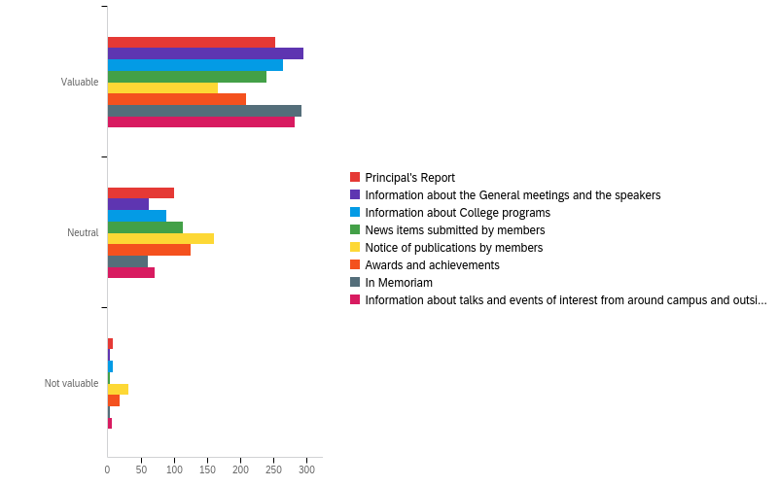
Q12 - The Newsletter is an important vehicle for keeping members informed about matters relating to UBC and College activities. Please rate the overall value to you of the sections in the Newsletter.

Slide 95
Q12 - The Newsletter is an important vehicle for keeping members informed about matters relating to UBC and College activities. Please rate the overall value to you of the sections in the Newsletter.
# | Field | Minimum | Maximum | Mean | Std Deviation | Variance | Count
1 | Principal's Report | 33.00 | 35.00 | 33.32 | 0.51 | 0.26 | 361
2 | Information about the General meetings and the speakers | 33.00 | 35.00 | 33.19 | 0.42 | 0.18 | 361
3 | Information about College programs | 33.00 | 35.00 | 33.29 | 0.50 | 0.25 | 361
4 | News items submitted by members | 33.00 | 35.00 | 33.34 | 0.50 | 0.25 | 357
5 | Notice of publications by members | 33.00 | 35.00 | 33.62 | 0.64 | 0.41 | 358

Slide 96
Q12 - The Newsletter is an important vehicle for keeping members informed about matters relating to UBC and College activities. Please rate the overall value to you of the sections in the Newsletter.
# | Field | Minimum | Maximum | Mean | Std Deviation | Variance | Count
6 | Awards and achievements | 33.00 | 35.00 | 33.46 | 0.60 | 0.36 | 352
7 | In Memoriam | 33.00 | 35.00 | 33.19 | 0.42 | 0.18 | 357
8 | Information about talks and events of interest from around campus and outside UBC | 33.00 | 35.00 | 33.23 | 0.46 | 0.21 | 359

Slide 97
Q12 - The Newsletter is an important vehicle for keeping members informed about matters relating to UBC and College activities. Please rate the overall value to you of the sections in the Newsletter.
# | Question | Valuable |  | Neutral |  | Not valuable |  | Total
1 | Principal's Report | 70.08% | 253 | 27.70% | 100 | 2.22% | 8 | 361
2 | Information about the General meetings and the speakers | 81.72% | 295 | 17.17% | 62 | 1.11% | 4 | 361
3 | Information about College programs | 73.41% | 265 | 24.38% | 88 | 2.22% | 8 | 361
4 | News items submitted by members | 66.95% | 239 | 31.93% | 114 | 1.12% | 4 | 357
5 | Notice of publications by members | 46.37% | 166 | 44.97% | 161 | 8.66% | 31 | 358

Slide 98
Q12 - The Newsletter is an important vehicle for keeping members informed about matters relating to UBC and College activities. Please rate the overall value to you of the sections in the Newsletter.
# | Question | Valuable |  | Neutral |  | Not valuable |  | Total
6 | Awards and achievements | 59.09% | 208 | 35.51% | 125 | 5.40% | 19 | 352
7 | In Memoriam | 81.79% | 292 | 17.09% | 61 | 1.12% | 4 | 357
8 | Information about talks and events of interest from around campus and outside UBC | 78.55% | 282 | 19.78% | 71 | 1.67% | 6 | 359

Slide 99
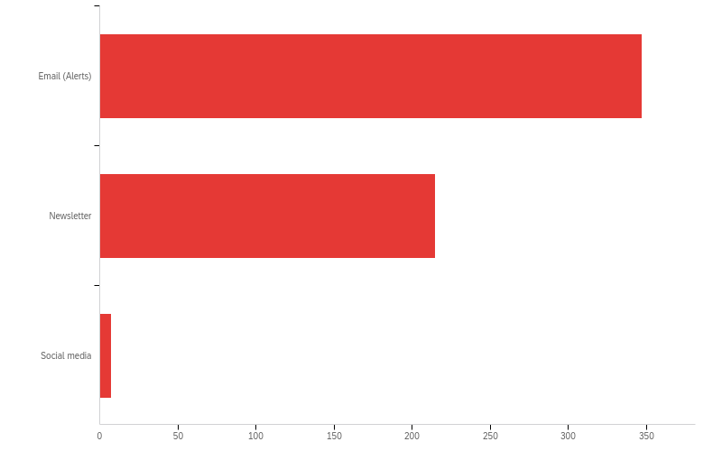
Q25 - How do you prefer to receive information from the College? Check all that apply.

Slide 100
Q25 - How do you prefer to receive information from the College? Check all that apply.
# | Answer | % | Count
1 | Email (Alerts) | 60.98% | 347
2 | Newsletter | 37.79% | 215
3 | Social media | 1.23% | 7
 | Total | 100% | 569

Slide 101
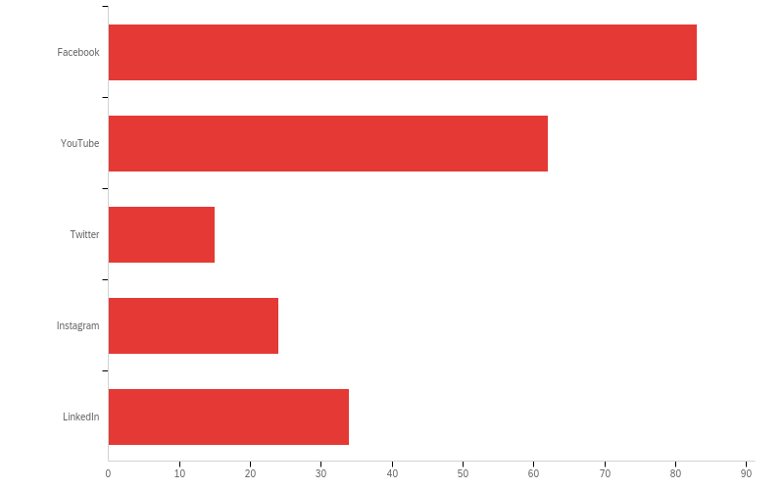
Q26 - Which social media channels do you use regularly? Check all that apply.

Slide 102
Q26 - Which social media channels do you use regularly? Check all that apply.
# | Answer | % | Count
1 | Facebook | 38.07% | 83
2 | YouTube | 28.44% | 62
3 | Twitter | 6.88% | 15
4 | Instagram | 11.01% | 24
5 | LinkedIn | 15.60% | 34
 | Total | 100% | 218

Slide 103
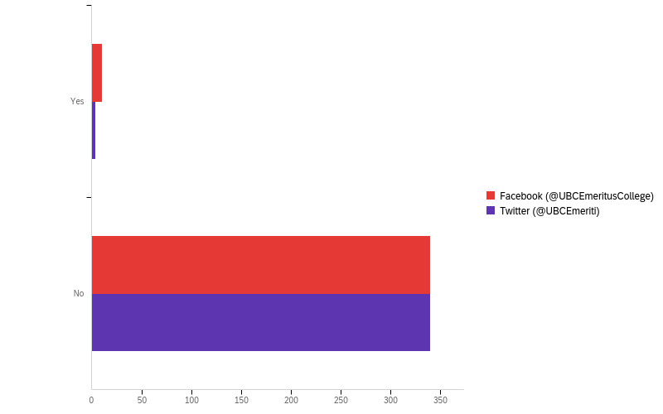
Q27 - Do you currently follow the College on any of the following social media channels?

Slide 104
Q27 - Do you currently follow the College on any of the following social media channels?
# | Field | Minimum | Maximum | Mean | Std Deviation | Variance | Count
1 | Facebook (@UBCEmeritusCollege) | 1.00 | 2.00 | 1.97 | 0.17 | 0.03 | 350
2 | Twitter (@UBCEmeriti) | 1.00 | 2.00 | 1.99 | 0.11 | 0.01 | 344

Slide 105
Q27 - Do you currently follow the College on any of the following social media channels?
# | Question | Yes |  | No |  | Total
1 | Facebook (@UBCEmeritusCollege) | 2.86% | 10 | 97.14% | 340 | 350
2 | Twitter (@UBCEmeriti) | 1.16% | 4 | 98.84% | 340 | 344

Slide 106
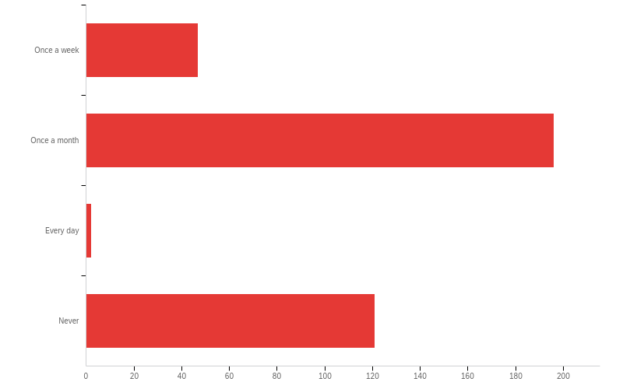
Q28 - How often do you visit the College's website?

Slide 107
Q28 - How often do you visit the College's website?
# | Field | Minimum | Maximum | Mean | Std Deviation | Variance | Count
1 | How often do you visit the College's website? | 1.00 | 4.00 | 2.54 | 1.08 | 1.17 | 366

Slide 108
Q28 - How often do you visit the College's website?
# | Answer | % | Count
1 | Once a week | 12.84% | 47
2 | Once a month | 53.55% | 196
3 | Every day | 0.55% | 2
4 | Never | 33.06% | 121
 | Total | 100% | 366

Slide 109
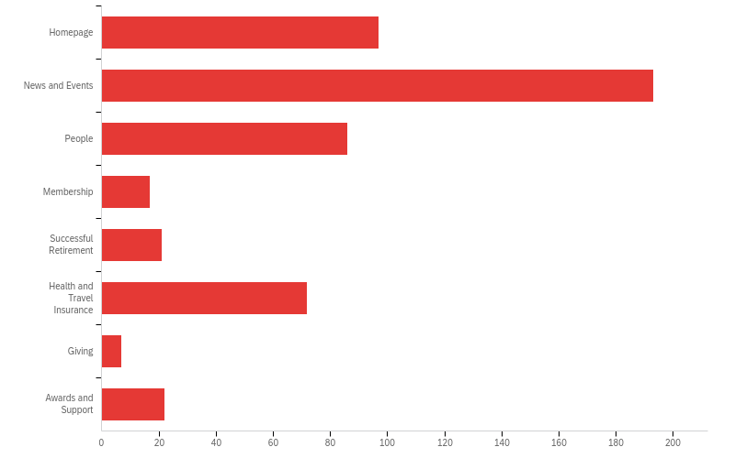
Q29 - Which pages do you go to most when you visit the College's website?

Slide 110
Q29 - Which pages do you go to most when you visit the College's website?
# | Answer | % | Count
1 | Homepage | 18.83% | 97
2 | News and Events | 37.48% | 193
3 | People | 16.70% | 86
4 | Membership | 3.30% | 17
5 | Successful Retirement | 4.08% | 21
6 | Health and Travel Insurance | 13.98% | 72
7 | Giving | 1.36% | 7
8 | Awards and Support | 4.27% | 22
 | Total | 100% | 515

Slide 111
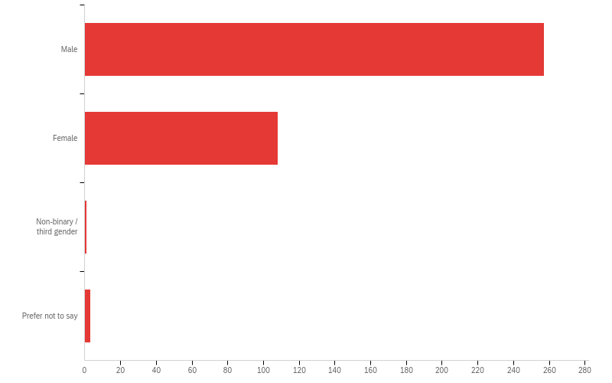
Q15 - People's interests and activities change as they go through different phases in life, and retirement is no exception. The College is keen to be relevant and accessible to all its members, and to offer programs of interest to those in both the early and later years of retirement. And, as gender influences career trajectories and patterns in academia during working years, we are going to analyze responses to determine if gender influences paths into and through retirement. What is your gender?

Slide 112
Q15 - People's interests and activities change as they go through different phases in life, and retirement is no exception. The College is keen to be relevant and accessible to all its members, and to offer programs of interest to those in both the early and later years of retirement. And, as gender influences career trajectories and patterns in academia during working years, we are going to analyze responses to determine if gender influences paths into and through retirement. What is your gender?
# | Field | Minimum | Maximum | Mean | Std Deviation | Variance | Count
1 | People's interests and activities change as they go through different phases in life, and retirement is no exception. The College is keen to be relevant and accessible to all its members, and to offer programs of interest to those in both the early and later years of retirement. And, as gender influences career trajectories and patterns in academia during working years, we are going to analyze responses to determine if gender influences paths into and through retirement. What is your gender? | 7.00 | 10.00 | 7.32 | 0.52 | 0.27 | 369

Slide 113
Q15 - People's interests and activities change as they go through different phases in life, and retirement is no exception. The College is keen to be relevant and accessible to all its members, and to offer programs of interest to those in both the early and later years of retirement. And, as gender influences career trajectories and patterns in academia during working years, we are going to analyze responses to determine if gender influences paths into and through retirement. What is your gender?
# | Answer | % | Count
7 | Male | 69.65% | 257
8 | Female | 29.27% | 108
9 | Non-binary / third gender | 0.27% | 1
10 | Prefer not to say | 0.81% | 3
 | Total | 100% | 369

Slide 114
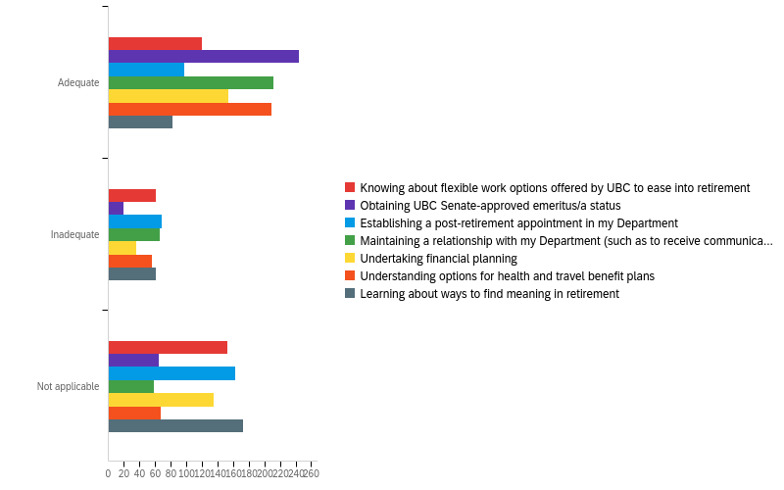
Q30 - For new retirees, there is an adjustment to one's new status and issues with finding "one's way" in a new phase of life, along with determining relationships with home departments and work colleagues. Guidance can come from many sources. What is your perception about the level of support you received to navigate your transition into retirement?

Slide 115
Q30 - For new retirees, there is an adjustment to one's new status and issues with finding "one's way" in a new phase of life, along with determining relationships with home departments and work colleagues. Guidance can come from many sources. What is your perception about the level of support you received to navigate your transition into retirement?
# | Field | Minimum | Maximum | Mean | Std Deviation | Variance | Count
1 | Knowing about flexible work options offered by UBC to ease into retirement | 9.00 | 11.00 | 10.10 | 0.90 | 0.81 | 333
2 | Obtaining UBC Senate-approved emeritus/a status | 9.00 | 11.00 | 9.45 | 0.80 | 0.64 | 328
3 | Establishing a post-retirement appointment in my Department | 9.00 | 11.00 | 10.20 | 0.87 | 0.75 | 328
4 | Maintaining a relationship with my Department (such as to receive communication of events; named on website) | 9.00 | 11.00 | 9.54 | 0.77 | 0.59 | 336

Slide 116
Q30 - For new retirees, there is an adjustment to one's new status and issues with finding "one's way" in a new phase of life, along with determining relationships with home departments and work colleagues. Guidance can come from many sources. What is your perception about the level of support you received to navigate your transition into retirement?
# | Field | Minimum | Maximum | Mean | Std Deviation | Variance | Count
5 | Undertaking financial planning | 9.00 | 11.00 | 9.94 | 0.94 | 0.89 | 325
6 | Understanding options for health and travel benefit plans | 9.00 | 11.00 | 9.57 | 0.81 | 0.65 | 332
7 | Learning about ways to find meaning in retirement | 9.00 | 11.00 | 10.29 | 0.85 | 0.72 | 316

Slide 117
Q30 - For new retirees, there is an adjustment to one's new status and issues with finding "one's way" in a new phase of life, along with determining relationships with home departments and work colleagues. Guidance can come from many sources. What is your perception about the level of support you received to navigate your transition into retirement?
# | Question | Adequate |  | Inadequate |  | Not applicable |  | Total
1 | Knowing about flexible work options offered by UBC to ease into retirement | 36.04% | 120 | 18.32% | 61 | 45.65% | 152 | 333
2 | Obtaining UBC Senate-approved emeritus/a status | 74.39% | 244 | 5.79% | 19 | 19.82% | 65 | 328
3 | Establishing a post-retirement appointment in my Department | 29.57% | 97 | 20.73% | 68 | 49.70% | 163 | 328
4 | Maintaining a relationship with my Department (such as to receive communication of events; named on website) | 63.10% | 212 | 19.64% | 66 | 17.26% | 58 | 336

Slide 118
Q30 - For new retirees, there is an adjustment to one's new status and issues with finding "one's way" in a new phase of life, along with determining relationships with home departments and work colleagues. Guidance can come from many sources. What is your perception about the level of support you received to navigate your transition into retirement?
# | Question | Adequate |  | Inadequate |  | Not applicable |  | Total
5 | Undertaking financial planning | 47.38% | 154 | 11.08% | 36 | 41.54% | 135 | 325
6 | Understanding options for health and travel benefit plans | 62.95% | 209 | 16.87% | 56 | 20.18% | 67 | 332
7 | Learning about ways to find meaning in retirement | 25.95% | 82 | 19.30% | 61 | 54.75% | 173 | 316

Slide 119
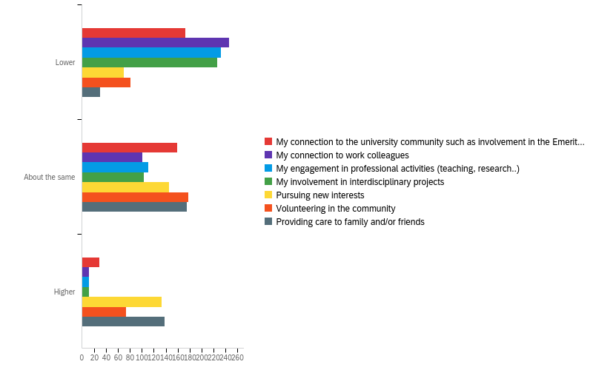
Q17 - Compared to your earlier years of retirement, has the following changed for you in recent years?

Slide 120
Q17 - Compared to your earlier years of retirement, has the following changed for you in recent years?
# | Field | Minimum | Maximum | Mean | Std Deviation | Variance | Count
1 | My connection to the university community such as involvement in the Emeritus College, Senate etc. | 1.00 | 3.00 | 1.60 | 0.63 | 0.40 | 361
2 | My connection to work colleagues | 1.00 | 3.00 | 1.35 | 0.54 | 0.29 | 359
3 | My engagement in professional activities (teaching, research..) | 1.00 | 3.00 | 1.38 | 0.55 | 0.30 | 355
4 | My involvement in interdisciplinary projects | 1.00 | 3.00 | 1.37 | 0.55 | 0.30 | 341

Slide 121
Q17 - Compared to your earlier years of retirement, has the following changed for you in recent years?
# | Field | Minimum | Maximum | Mean | Std Deviation | Variance | Count
5 | Pursuing new interests | 1.00 | 3.00 | 2.18 | 0.74 | 0.55 | 348
6 | Volunteering in the community | 1.00 | 3.00 | 1.98 | 0.68 | 0.47 | 333
7 | Providing care to family and/or friends | 1.00 | 3.00 | 2.31 | 0.63 | 0.39 | 343

Slide 122
Q17 - Compared to your earlier years of retirement, has the following changed for you in recent years?
# | Question | Lower |  | About the same |  | Higher |  | Total
1 | My connection to the university community such as involvement in the Emeritus College, Senate etc. | 47.92% | 173 | 44.04% | 159 | 8.03% | 29 | 361
2 | My connection to work colleagues | 68.52% | 246 | 28.13% | 101 | 3.34% | 12 | 359
3 | My engagement in professional activities (teaching, research..) | 65.35% | 232 | 31.27% | 111 | 3.38% | 12 | 355
4 | My involvement in interdisciplinary projects | 66.28% | 226 | 30.21% | 103 | 3.52% | 12 | 341

Slide 123
Q17 - Compared to your earlier years of retirement, has the following changed for you in recent years?
# | Question | Lower |  | About the same |  | Higher |  | Total
5 | Pursuing new interests | 20.11% | 70 | 41.67% | 145 | 38.22% | 133 | 348
6 | Volunteering in the community | 24.32% | 81 | 53.45% | 178 | 22.22% | 74 | 333
7 | Providing care to family and/or friends | 8.75% | 30 | 51.02% | 175 | 40.23% | 138 | 343

Slide 124
Q32 - What is/was the most helpful resource or type of retirement-planning support that you received?
What is/was the most helpful resource or type of retirement-planning support that you received?
I did not receive any special guidance regarding retirement. But I also did not ask for help. I will say that whenever I contacted them the pension office was very helpful. However, I have not tried to contact them for a number of years.
Talking to other (retired) colleagues
Alternatives for dealing with the UBC faculty pension
Received none
None
Benefits,
Workshops on financial planning. Various UBC pension options.
Information about pension income.
NONE
Word of mouth recommendations by colleagues who had retired before me

Slide 125
Q32 - What is/was the most helpful resource or type of retirement-planning support that you received?
What is/was the most helpful resource or type of retirement-planning support that you received?
Financial planning by UBC pension office.
None
FPP sessions Emeritus colleagues
UBC Library, annual pension meetings, parking, email
Seminars on financial planning
Visiting potential retirement homes
medical insurance
Think forward, BUT do not forget past connections and important tasks--plus stay involved with young people(students) and the community at large
Advice from the Pension Plan office.
9
Group and individual Information sessions with the UBC Faculty Pension Plan people.

Slide 126
Q32 - What is/was the most helpful resource or type of retirement-planning support that you received?
What is/was the most helpful resource or type of retirement-planning support that you received?
a financial planner years before retirement
Staying on faculty email lists to know what is going on, being easily able to access information about things like medical benefits and what other retired folks are doing. Benefitted from presentations and updating and some special events.
how to decide which was the best plan for me financially so that I would not have to worry about money
Speaking to friends and researching the literature about retirement. Having a plan, taking stock of my interests and creating a new daily schedule for myself
Advice on the UBC Pension plan and benefits and how to allocate my payments from the RRIF and LIF.
An investment club mainly of retirees of similar vintage from chemistry which met monthly to decide what to do with our pensions. At the time we all had to withdraw our pensions from the UBC plan at age 71.
Extended Health and Travel Plan
information sessions on insurance

Slide 127
Q32 - What is/was the most helpful resource or type of retirement-planning support that you received?
What is/was the most helpful resource or type of retirement-planning support that you received?
seminars of FPP
Talking to colleagues
Medical and travel insurance. Fiscal support for research costs.
Emeritus College assistance with my membership and health/travel insurance benefit
MD Management
Health and travel insurance
Information about retirement benefits.
Not retired
Advice to ensure access and continued work with an independent financial planner
Financial planning and financial advising through my usual adviser at Nesbitt Burns; advice from my accountant; and advice from my lawyer. Reading the Globe and Mail business and investments sections.

Slide 128
Q32 - What is/was the most helpful resource or type of retirement-planning support that you received?
What is/was the most helpful resource or type of retirement-planning support that you received?
There was an information session pre-retirement. I can’t recall an others but I did not often work on campus.
Financial planning by my personal financial planner
Financial Planning and Benefits Planning and stories from those who enjoy retirement.
presentations prior to retirement
Self-administered pension with Sun Life
Entertainment - film group; Travel insurance information etc.
I used a financial planner, not connected to UBC but with one of the major Canadian bank.
Nond
Retirement planning seminars, specifically on pension options and taxation issues.
Advice and assistance from Pensions and Finance Department, Human Resources

Slide 129
Q32 - What is/was the most helpful resource or type of retirement-planning support that you received?
What is/was the most helpful resource or type of retirement-planning support that you received?
Pension and health insurance information
Learning how to handle my finances myself. I learned this long ago.
Discussions with UBC FPP admin office
Pre-retirement meeting and binder of slides
Extended Health and Travel Plans
Comparisons of insurance plans
My Financial Advisor
Financial planning
From my personal financial planners.
Presentations on UBC Faculty Pension Plan Retirement Options
Pre retirement seminars

Slide 130
Q32 - What is/was the most helpful resource or type of retirement-planning support that you received?
What is/was the most helpful resource or type of retirement-planning support that you received?
The College provides a ‘support’ network even though I have not taken undue advantage, Knowing it is there at this time of continued transitioning, It feels supportive.
Benefits
Pre-retirement sessions at Western were excellent.
N.A
Self. Thought about retirement long in advance. Did it by stages.
Lectures at UBC about retirement planning
Standard retirement planning day, including financial information.
ubc faculty financial/retirement meetings
During my first years of retirement, the head of our Sociology/History department at UBCO continued to support my research and I felt very much still a department member.
pension and health care advice

Slide 131
Q32 - What is/was the most helpful resource or type of retirement-planning support that you received?
What is/was the most helpful resource or type of retirement-planning support that you received?
Assistance from College members in sorting out financial and insurance details
FInancial planning series and pension information.
Recommendation to make an appointment with a financial planner.
Liraary
TIAA/CREF; Sun Life Insurance, Nicola Wealth Management I put my retirement funds here, rather than in the UBC pension fund.
I subscribed to a weekly newsletter that described general principles of investing. I don't know if the newsletter is still being published.
Financial advice
FPP retirement planning options seminar; Extended medical/travel insurance options (Emeritis College seminar & report)
information sessions about how to handle my assets in the UBC pension fund
FOS/University retirement seminars/talks

Slide 132
Q32 - What is/was the most helpful resource or type of retirement-planning support that you received?
What is/was the most helpful resource or type of retirement-planning support that you received?
Did not received any
Friends and UBC retirement meetings
Extra medical insurance programs
Talk by HR; presentation by external financial adviser. In truth, there was very little from the UBC end; but this was a long time ago.
Information about pension plan
Faculty Association- organized seminars.
The pre-retirement information sessions, especially related to Financial Planning and to Health & Travel Insurance, were very helpful. It would be helpful to have another similar session - recapping these issues - shortly after Retirement, as the reality can be quite overwhelming and, of course, the ground is constantly shifting - especially having retired in this past year of COVID.
Just talking with colleagues who had already transitioned to retirement or those planning on retirement.

Slide 133
Q32 - What is/was the most helpful resource or type of retirement-planning support that you received?
What is/was the most helpful resource or type of retirement-planning support that you received?
Financial planning
Financial planning advice from "downtown company".
Financial management
Library
The extended health information
Frequent email and news from the Pensions office.
Editing and reviewing articles and book manuscripts
N/A
Accountant
My Assante financial advisor.
The retirement planning seminars were helpful.

Slide 134
Q32 - What is/was the most helpful resource or type of retirement-planning support that you received?
What is/was the most helpful resource or type of retirement-planning support that you received?
UBC Pension Plan staff
Ongoing news of pensions
Pension info Help from members on health insurance😃
Managing pension...
Financial
Health insurance
Doing my own research and reading on the topic.
The emeritus web site regarding comparison of insurance options. The people who prepared that did a great service.
retirement seminars with financial planning
Financial planning and information about additional travel and health insurance.
Back when I retired (2006), very little information or support was provided. You were largely on your own.

Slide 135
Q32 - What is/was the most helpful resource or type of retirement-planning support that you received?
What is/was the most helpful resource or type of retirement-planning support that you received?
Meeting with Lorraine.
Extended health and travel insurance info; much appreciated!
Announcement of the various information sessions such as UBC Pension retirement planning options, information brochures on the UBC RSB, making appointment with a tax accountant for retirement planning strategies. It basically was a time of talking to other colleagues to learn what you could. Hit and miss. Extremely few comprehensive retirement planning supports in place during my time of retirement.
FPP discussion and information
advice from my colleagues and friends. I attended many financial planning sessions but they covered too much and the details were lost on me.
Informal conversations with recently retired colleagues. A pension planning session put on by the Faculty Pension Plan staff about 18 months before my retirement was also very useful.
I did not actually receive such support. My last year at UBC I was on leave to take the position of lead scientist for a major water and environmental management program in California. At the end of that assignment I returned to Canada as a retired faculty member

Slide 136
Q32 - What is/was the most helpful resource or type of retirement-planning support that you received?
What is/was the most helpful resource or type of retirement-planning support that you received?
post-retirement appointment to a new department
Lorraine Hezeltine FPP seminars
interaction with UBC Faculty Pension Plan personnel
The retirement workshops that were offered -- I remember attending one in 2016 that was particularly helpful.
Didn't receive or need any
The 3-hour pre-retirement session with the accompanying binder of copy of slides and notes
A seminar provided by UBC, a very knowledgeable colleague in the department and ongoing support from Lorraine Heseltine in the Pensions department of Human Resources
None needed but good to know it was there if needd
Extended Health information
My department never queried my desire to continue to do research, supported my grant applications, and provided the necessary lab space, office space, facilities for students, postdocs and employees, etc.

Slide 137
Q32 - What is/was the most helpful resource or type of retirement-planning support that you received?
What is/was the most helpful resource or type of retirement-planning support that you received?
I found the financial planning and the health planning most useful.
A seminar on financial planning
Health and finance.
Pension information sessions
Allowed me to choose my path
health insurance information
Direct contact with HR back in the dark ages
Financial planning provided local bank
financial planning for retirement
Meetings by HR
FPP seminars; insurance guidance

Slide 138
Q32 - What is/was the most helpful resource or type of retirement-planning support that you received?
What is/was the most helpful resource or type of retirement-planning support that you received?
UBC | Okanagan Campus Faculty Pension Plan Forum
A book (Breaking the Watch) by an anthropologist friend, Dr. Joel Savishinsky provided very valuable insight.
not much. The FA and HR had sessions in which the participants exchanged ideas. Little hard information.
Financial subsidy for certified financial planner consultant
Annual lectures on investment, etc.
Financial planning from Faculty Pension Plan
Financial Planning
Financial planning with personal consultant funded by UBC was extremely helpful.
UBC HR and Pension Plan workshops
finacial

Slide 139
Q32 - What is/was the most helpful resource or type of retirement-planning support that you received?
What is/was the most helpful resource or type of retirement-planning support that you received?
financial planning support;
Needed no help. support. And there was none.
a financial advisor from day one of my career.
My own research and professional development that I gave
None
Pension plan seminars
Health Benefits
Emeriti status
Regular UBC Pension Forum sessions; Retirement Workshops; membership on Faculty Association Executive during the abolition of mandatory retirement, and participation in the creation of the Retirement Options program for the university.
Understanding pension – Lorraine Heseltine deserves UBCs highest recognition

Slide 140
Q32 - What is/was the most helpful resource or type of retirement-planning support that you received?
What is/was the most helpful resource or type of retirement-planning support that you received?
Information on the FPP. Lorraine is an amazing resource. Also, the information on the benefit and travel plans are very good.
UBC human resources days on retirement planning.
Can't really say. Didn't get any support to speak of.
From my financial advisor
Connection with Lorraine Heseltine
HR-sponsored retirement workshop
Financial SEminars
Opportunity to work on a new project
Materials from the pension plan
Johnstone's health insurance plan. Good job Paul Marantz!! Opportunities to meet other retirees.

Slide 141
Q32 - What is/was the most helpful resource or type of retirement-planning support that you received?
What is/was the most helpful resource or type of retirement-planning support that you received?
medical
Financia information
instruction on navigating the financial vehicles like RRIF's and LLIF'S . Eventually I decided to take my retirement fund outside of the University pension plan. It is still a challenge adapting to less income however. Doing worksheets on monthly expenditures etc would have helped.
Pension Plan information
Financial planning, even though it could be greatly improved.
Financial advice, mainly from Paul Marantz
Newsletter in
FPP sessions
Health benefits
Information/seminars about pension plan/finances.

Slide 142
Q32 - What is/was the most helpful resource or type of retirement-planning support that you received?
What is/was the most helpful resource or type of retirement-planning support that you received?
Pension
Workshops to prepare for retirement and meeting the Lorraine Heseltoine who does a great job
financial planning seminar re: UBC pension plan
Financial advisor
Advice from wife
Help from Lorraine Hesseltine
Workshops and seminars both from the UBC Pension Plan office and from the Faculty Association. It was important to have these workshops spaced over one’s career.
NSERC Grant
Word of mouth from colleagues
Little or no retirement-planning support was effectly available in 2001! This was a serious UBC shortcoming and involved a challenging transition process from full-time academic work to post-retirement. Presumably this is now being dealt with as the university seems to become increasingly more sophisticated in handling these matters especially via with the new Emeritus College. Most distressing back in the day at retirement time was the lack of substantial help and information regarding the transfer and management of our university PENSION, including an anxiety-ridden learning curve and search for a suitable financial management group in which one could have confidence and peace of mind.

Slide 143
Q32 - What is/was the most helpful resource or type of retirement-planning support that you received?
What is/was the most helpful resource or type of retirement-planning support that you received?
Health information
I taught faculty retirement planning seminars to UBC, UVic, and a couple of BC colleges, so knew what to look for. My concern is that many approaches to helping folks with retirement focus on financial/legal planning and omit what I know to be the most important aspects - caring for mental and physical health, connections to community, new relations with spouses as life changes
My Financial Advisor and the UBC Association of Professors Emeriti
Group meals and discussions
Membership in UBC APE
None
My adult son and daughter who are both academics.
Cz
Advice about extended medical benefits

Slide 144
Q32 - What is/was the most helpful resource or type of retirement-planning support that you received?
What is/was the most helpful resource or type of retirement-planning support that you received?
Financial advice
Travel insurance
Only the documentation I got from the Faculty Pension Office.

Slide 145
Q33 - How could UBC and/or the UBC Emeritus College better support faculty during their pre- and early post-retirement periods? We welcome your ideas.
How could UBC and/or the UBC Emeritus College better support faculty during their pre- and early post-retirement periods? We welcome your ideas.
I always had a number of outside interests and following retirement I did consulting work for about 7 years and so made a gradual transition to full retirement. My wife an I also relocated to the Okanagan so that maintaining contact with the main campus became difficult. I was involved in a couple of events at the Okanagan campus but as it was more than an hour's drive from my home it was not easy to develop a productive relationship. In some ways the pandemic has been helpful because Emeritus groups are meeting online and that has allowed me to reconnect with some university related activities. None of this is really relevant to the question but, as it is more than a decade since I retired I expect new retirees will have a very different experience.
Never forget that UBC is an education institution and not a degree mill ! UBC (should) must give our senior students a taste of professional work. That was, and is the guiding principle of the Eng. Physics program, but ought to be implemented in some other departments That was lacking in many programs when I retired
Keep holding the meetings with a speaker. They give a chance for retired faculty to reconnect with one another
Earnestly performing well.
??

Slide 146
Q33 - How could UBC and/or the UBC Emeritus College better support faculty during their pre- and early post-retirement periods? We welcome your ideas.
How could UBC and/or the UBC Emeritus College better support faculty during their pre- and early post-retirement periods? We welcome your ideas.
Better ongoing health benefits support. Coverage should be longer than for one month after one’s retirement date. Workshops on preparing for retirement. These were essentially non existent in the year ahead of my planned retirement.
I think COVID showed us how much easier it would be to join Emeritus events virtually.
So many retirees move away or live at a distance (which is also true pre-retirement) and the Newsletter plus General and particular meetings of groups, on-line during the pandemic, this should be continued after the pandemic to cope with the distance that separates many retirees from UBC .Campus
Something all the lines of the above would have been very helpful then.
Keep up the community minded work.
Not sure, awhile ago for me now.
Is it OK to NOT be interested in continuing professional activities and being actively involved? Much judgment from others and self-deprecation is common.
None

Slide 147
Q33 - How could UBC and/or the UBC Emeritus College better support faculty during their pre- and early post-retirement periods? We welcome your ideas.
How could UBC and/or the UBC Emeritus College better support faculty during their pre- and early post-retirement periods? We welcome your ideas.
Provide meeting/desk space
I think the UBC Emeritus College provides great support but my life has been so busy with research, writing, speaking events, and community activities that I have not found the time to enjoy as much of the college activities that I would have liked.
Have speakers from retirement homes
none come to mind--a good College to associate with.
Better IT support for professional activities. Let all members know whom to contact if we need IT help.
Sorting out Emeriti/ae issues that are Board of Governors related from those that are Senate related. In my case (circa 2015), documents I was presented with were inconsistent.
Work to reduce ageism.
Promote a more standardized process amongst all UBC Faculties in their recommendations of Senate-approved Emeritus/a status to retired faculty members (including the clinical professors).

Slide 148
Q33 - How could UBC and/or the UBC Emeritus College better support faculty during their pre- and early post-retirement periods? We welcome your ideas.
How could UBC and/or the UBC Emeritus College better support faculty during their pre- and early post-retirement periods? We welcome your ideas.
Encourage departments and faculties to reach out, stay connected and make use of the knowledge and experience of their emeritus faculty.
I had a plan that worked and I benefited from continued contact with those who helped me before the change that became retirement retirement
I live in Victoria, BC and therefore access to in-person activities at the Emeritus College has not been feasible. I did not increase my participation online once activities became virtual due to COVID-19 because did not want to get used to it and then have to stop and feel the loss of it once things go back to normal. I am not sure how many of us reside in parts of the Province outside Vancouver. One thing the Emeritus College could do is to acknowledge that we exist, and think how to keep us engaged virtually after the pandemic.
Don’t know what is available now.
Get a better extended benefits plan I’ve outlived mine.
University Departments could host an annual presentation from retired members called "The Retired Life" that would present different ways to live a meaningful life in retirement.

Slide 149
Q33 - How could UBC and/or the UBC Emeritus College better support faculty during their pre- and early post-retirement periods? We welcome your ideas.
How could UBC and/or the UBC Emeritus College better support faculty during their pre- and early post-retirement periods? We welcome your ideas.
Strengthen relationships with academic units by clarifying and enhancing possible roles and relationships.
I am just finishing being an Executor for and estate of a former colleague (not a UBC colleague) and I have realized that although I got a lot of useful information from the retirement planning sessions I attended pre-retirement, that are a lot of issues related to probate and other aspects of managing an estate that I have learned that I think most retirees would want to have an opportunity to learn more about as they prepare for retirement. A very specific issue that actually shocked me was the difficulty I had gaining control over bank accounts for the estate. There is a lot of detail here, so I will just summarize -- even after Probate was granted and I was legally the Executor, the bank (TD Canada Trust) does not allow me online access to the accounts that I set up for the Estate, which means I have had to revert to banking practices that I abandoned decades ago for my personal banking. I currently have no direct access to statements for accounts, no ability to do e-transfers via the web, and I was not able to set up a credit card or a debit card to pay expenses on behalf of the estate. I would be more than willing to share my experience if there is an interest in pursuing these questions. I am personally trying to figure out how my Executor will be able to avoid the difficulties I experienced, but I do not as yet have enough information about alternatives to know what to do.
Emphasize transition to retirement issues

Slide 150
Q33 - How could UBC and/or the UBC Emeritus College better support faculty during their pre- and early post-retirement periods? We welcome your ideas.
How could UBC and/or the UBC Emeritus College better support faculty during their pre- and early post-retirement periods? We welcome your ideas.
Networking, Focus on health and exercise, Meditation
Improve options for post-retirement contribution to department, faculty and/or university; there are many options where voluntary contribution of time, effort and expertise would be of value to our currently employed colleagues.
The support has been very satisfactory.
One on one coffee chats between just retired and long retired
I think COVID has severely affected the landscape of retirement, especially during the early post-retirement period, which was me. Getting involved and finding new avenues of enjoyment/fulfillment was difficult since I really looked forward to enjoying more of the campus activities, both Emeritus and other. Hopefully, things can get back to normal, or a new normal in the next year or two.
Continue present provision with reflections by those at various stages of retirement.
The College is going a great job. It behooves members to get involved and to take advantage. I believe I have benefited from the work of the College for that I am truly grateful. I could do more to contribute, but do have ongoing commitments, thus need to give myself ‘space’ to define my transitioning path. I do not relate to the term ‘retirement’. I resonate more to ‘re-inventing’, ‘re-tooling’, ‘re-firing’. May be if the College rhetoric reflected more of these sentiments, I would resonate more to participating. Just a personal thing...

Slide 151
Q33 - How could UBC and/or the UBC Emeritus College better support faculty during their pre- and early post-retirement periods? We welcome your ideas.
How could UBC and/or the UBC Emeritus College better support faculty during their pre- and early post-retirement periods? We welcome your ideas.
I think the College has been very supportive
Both are doing a good job
Giving retirees a choice to have a retirement mentor i.e., some who is a few to many years ahead in the retirement stage of life. Low commitment hours, just having coffee together once a month or bi-monthly. I’m part of a retiree « support group » (as if our level of societal privilege needs this :) ) with a few people from my former School. Mostly it’s social and low-key and over coffee, however we’ve also supported each other through deaths and other experiences of transitions as we age eg, loss of perfect health, increasing physical disability.
well, maybe we should plan within 6 months of retirement a gathering with a good speaker but lots of interaction
But when the head was replaced by someone new, a non-sociologist from another university, all the support was withdrawn. It has been difficult to keep my research projects going without departmental support.
connect new retirees with persons nearing retirement. Give encouragement.
Excellent job; no suggestions at this time.

Slide 152
Q33 - How could UBC and/or the UBC Emeritus College better support faculty during their pre- and early post-retirement periods? We welcome your ideas.
How could UBC and/or the UBC Emeritus College better support faculty during their pre- and early post-retirement periods? We welcome your ideas.
Be sure that we know who has retired and connect with them and invite them to meetings, events and include them in all that the college offers.
UBC pensions offered me practical support about the alternative things I could do with my pension when I retired.
I was supported as much as I wanted. I don't think I'd change anything for myself.
-like the pension fund 'education session', perhaps have sessions that cover more about opportunities for retired professors at the university and in the community
I think that the college is doing this
Since I retired 17 years ago, things have changed significantly and I don't think my experience is very relevant to today's faculty getting ready to retire.
Sending out information about the College to members approaching retirement.
As I am still formally supervising PhD students and participating in grant-supported research, I was surprised and seriously dismayed to discover that ARTS ISIT does not provide upgrades to retired/Emeriti faculty for computer software like Adobe Acrobat Pro. I absolutely need this software for my research and graduate student supervision, and it is very expensive to purchase this independently - especially on a post-retirement income.

Slide 153
Q33 - How could UBC and/or the UBC Emeritus College better support faculty during their pre- and early post-retirement periods? We welcome your ideas.
How could UBC and/or the UBC Emeritus College better support faculty during their pre- and early post-retirement periods? We welcome your ideas.
Good question - I think just letting people know what is available. Maybe getting groups together that are planning retirement to brainstorm and discuss what everybody is going to do. We are all very different but there are common bonds or things that we can relate to.
Have focus groups for newly retirees to better understand what they need.
Need very thorough education of pre-retirement members, especially younger ones, as to what the options are, what to expect, etc.
Provide Emeriti programming/services for faculty off campus, for example, the drive to UBC from the north shore is too onerous.
Just keep doing what you have been doing
A great deal of our post-retirement life involves writing--professional, political (in a broad sense of that term), and in service of our roles as public intellectuals. More advice and help to maintain a writing life might be welcomed by many (most?) retirees, esp. people more than 10 years into retirement.
You are doing well

Slide 154
Q33 - How could UBC and/or the UBC Emeritus College better support faculty during their pre- and early post-retirement periods? We welcome your ideas.
How could UBC and/or the UBC Emeritus College better support faculty during their pre- and early post-retirement periods? We welcome your ideas.
Department heads should be mandated to learn about available retirement planning resources for their department members and should be expected at least annually to share this type of information at a departmental meeting/rounds etc.
N/A
Financial planning
The help should start in one’s department with guidance on who to contact with various types of questions. A pamphlet would do....
Advice on gradual retirement or “soft landing”
Parties?
I think there should be a gradual introduction to the Emeritus College information and services as you get closer to Retirement. Even though I knew it was coming, retirement was upon me before I knew it. Perhaps some kind of one on one contact leading up to that date.
I have no suggestions for change at present.

Slide 155
Q33 - How could UBC and/or the UBC Emeritus College better support faculty during their pre- and early post-retirement periods? We welcome your ideas.
How could UBC and/or the UBC Emeritus College better support faculty during their pre- and early post-retirement periods? We welcome your ideas.
Supporting the University's pre-retirement workshop; ensuring that faculty approaching retirement are aware of the Emeritus College and the resources on its website.
Departments should be better informed about the contributions of Emeriti. IT support and a way to preserve academic archives on the UBC network should be provided. For an easy transition and to avoid UBC receiving unsorted archival materials upon the death of a member. The transition from paper to electronic archives should be guided with UBC standards that can be easily followed.
Not all of us want to continue with their previous UBC scholarly pursuits and interests. Time to do new things and move on. More advice with the “moving on” from UBC would be helpful. E.g. how to learn to play an instrument if u have never done it before.
Retirement needs to be part of the culture at UBC, starting from the time one is employed. There needs to be a coordinated UBC plan, which includes the Emeritus College, that addresses the many and inter-related aspects pertaining to retirement. It goes way beyond financial planning and health benefits. One's career is an intricate part of one's identity, an often overlooked and underestimated component of retirement-planning. At the moment, UBC and the Emeritus College offers a series of retirement-related sessions that are most useful but there does not seem to be an overall university strategy that incorporates retirement planning through out one's work life. As well, it is totally uneven on how informed administrative heads are about the retirement resources and options, and their comfort level in discussing and advising. Furthermore, even though mandatory retirement departed, there is still the attitude that once retired, we have little or no need for your experience and expertise to assist new faculty and the student body, as well as department heads in future planning. |A dreadful waste of a valuable resource related to those who wish to make continuing contributions. In addition, it is demeaning to those who have provided years of commitment to UBC to be brushed aside. Thank heavens for the Emeritus College where one can get support in making a successful transition into retirement, get answers and strategies to approach one's department.

Slide 156
Q33 - How could UBC and/or the UBC Emeritus College better support faculty during their pre- and early post-retirement periods? We welcome your ideas.
How could UBC and/or the UBC Emeritus College better support faculty during their pre- and early post-retirement periods? We welcome your ideas.
Like myself, ,most of my colleagues who are now retired had no problem transitioning into retirement which has been a gradual shift away from the university towards other activities. For a while it seemed that the only difference was that I was off the payroll in relation to supervising doctoral candidates. There is no recognition of this work. When I retired, I did ask about remuneration but was told that was not possible. It seems that offering an honorarium is tied to specific units. I think there would be a university-wide fund to recognize this work. I would use that money to support awards for students. The workshops offered could involve panel presentations from retired colleagues about their experiences with lots of time left for sharing and discussion. Everyone is different so there is no one profile. .
My perception is that the university offers a number of kinds of assistance to help with retirement. Since I did not take advantage of any of these I can't comment.
Make certain that new retirees are valued, say by featuring a brief biographical sketch in the newsletter or on website
Connecting with retirees as they plan for retirement and as they undertake their retirement.
More information about acquiring new post-retirement hobbies (interests) and opportunities for meeting and discussion with other retirees, ie., establishing new interests and social connections.

Slide 157
Q33 - How could UBC and/or the UBC Emeritus College better support faculty during their pre- and early post-retirement periods? We welcome your ideas.
How could UBC and/or the UBC Emeritus College better support faculty during their pre- and early post-retirement periods? We welcome your ideas.
Might be interesting to see if the Pension Group can provide some figures on whether the pay into the Registered retirement fund is really worth-while financially. As my income now is far in excess of what I earned prior to retirement I could really do without the compulsory withdrawal from the RRIF adding to my taxable income. I could have better spent the money that I put into the RRIF when I was still working.
Maybe more planning seminars and/or discussion about the different pathways people take, and how important it is to have already developed interests and social activities outside the academic field.
I think we do a good job But the potential retiring faculty need to be made aware of us!!
Better guidance around nuts and bolts of pension details -- how to reallocate sources of income after retirement; clarity around insurance options;
Greater presence on the Okanagan Campus
Most emeriti are not active researchers, so programs to engage them socially or intellectually are important.
Ease maintaining contact with the department from which they retired.

Slide 158
Q33 - How could UBC and/or the UBC Emeritus College better support faculty during their pre- and early post-retirement periods? We welcome your ideas.
How could UBC and/or the UBC Emeritus College better support faculty during their pre- and early post-retirement periods? We welcome your ideas.
I really had no contact with the Emeritus College before retirement. My colleagues at UBC just don't retire (!!) so really had no sense of the challenges ahead in terms of maintaining research and connection. Financial planning was what I focussed on, and I'm glad I did. But I was surprised at the issues involved in sense of self. I didn't expect there to be any difference, but there has been. Pandemic hasn't helped, of course.
Some departments have a culture of not recognizing emeritii, regardless of the prestige or contribution of the individual. I do not see any easy ways to address this, but if the College could undertake a study of the differing ethos with regards to retirees that might be useful. I say might because I think this is a ground up issue hard to remedy from a top down position.
As above, making some talks available as recordings. Many look to be so interesting. It's often difficult to join live by Zoom etc because of large time differences.
I think that the emeritus college is a wonderful idea. My issue comes with the leaders of the Emeritus college who tend to be the same leaders of the administration of the University when I was an active faculty member. If I was disappointed with their leader ship back then, I have a little interest in learning about their leader ship now. However, I am proud to have been a UBC faculty member and still promote the University whenever I can

Slide 159
Q33 - How could UBC and/or the UBC Emeritus College better support faculty during their pre- and early post-retirement periods? We welcome your ideas.
How could UBC and/or the UBC Emeritus College better support faculty during their pre- and early post-retirement periods? We welcome your ideas.
Advertise our activities more.
More flexibility in continuing Departmental/Hospital activity at a reduced level. Invitations to Departmental academic and social events to keep in touch with colleagues.
more activities related to planning and preparing
I would have welcomed a chance to talk to older retirees when I first retired.
Benefits information and choices
A programme of Easing Into Retirement covering many of the topics noted above. Each retiree will be quite different from another, and this would require customizing.
Add "Community volunteer service" category to the official UBC CV, and take the category seriously at all stages of career progress and merit reviews. Actively educate pre-retirement members about Retirement Options well in advance of retirement. End the subsidy for continuation of scholarly activities: it only enables some members to avoid "easing into retirement."
Graduate from the so-ingrained petty cultures of academic pecking order. Probably impossible.

Slide 160
Q33 - How could UBC and/or the UBC Emeritus College better support faculty during their pre- and early post-retirement periods? We welcome your ideas.
How could UBC and/or the UBC Emeritus College better support faculty during their pre- and early post-retirement periods? We welcome your ideas.
Probably should develop program specifically to link up with and engage faculty in the 1-2 years BEFORE they retire.
More networking opportunity ; provide membership list with contact possibility
My unit shows no interest in my participation in any ongoing activities and no respect for my previous contributions, and I'd have to say that is true for the Faculty as well. My current professional activities, which are fairly extensive, have no connection with UBC. I think there is general ignorance of the roles that Emeritus faculty could play. Perhaps the College could educate them, or work with senior leadership - not at the President Ono level - he seems very supportive, but perhaps the Dean level. My affection for UBC has gone way down based on how I have been treated during retirement. My satisfaction level indicated below has nothing to do with UBC - in fact, I am happy to be away from it.
Perhaps more communication with faculty who are approaching retirement (even though that is difficult to define these days), to let them know about info/resources available through College.
Force department heads to better explain retirement options to faculty.
Let them decide then providee support - help them achieve what they desire.

Slide 161
Q33 - How could UBC and/or the UBC Emeritus College better support faculty during their pre- and early post-retirement periods? We welcome your ideas.
How could UBC and/or the UBC Emeritus College better support faculty during their pre- and early post-retirement periods? We welcome your ideas.
Wish the health care benefits as faculty did not change so drastically on retirement. Most civil servants have the same benefits after retirement
Monitoring changes e.g. income tax, health, financial planning that might affect retirees. Enabling cross-department collaborative activities - UBC remains a bunch of Dept silos.
no comment
I have enjoyed listening to some of the panel discussions in areas of expertise and would like to listen/watch a lot more. I would like to hear more on the future/relevance of the University as an institution as our society continues to evolve at warp speed.
Panel discussion or talks on adjustments and opportunities in retirement life
Difficult to say given both the recency of my retirement and the suffocating effect of COVID.
In person meetings. Hopefully
by fostering dept/faculty emeritus groups (dept reps etc)

Slide 162
Q33 - How could UBC and/or the UBC Emeritus College better support faculty during their pre- and early post-retirement periods? We welcome your ideas.
How could UBC and/or the UBC Emeritus College better support faculty during their pre- and early post-retirement periods? We welcome your ideas.
Give them more information from standpoint of people who are retired.
Let's get out of the CoVid hole and reactivate personal meetings; I greatly miss this .
talks on retirement life styles
Make the retirement workshops and sessions on different times of the day and different days of the week in different terms, please! I had problems attending because these were at the same time and day of the week each term, and I had a teaching conflict.
See above regarding help in financial planning and the management of the university pension.
See above - I think that faculty nearing retirement should think about how their relationships will change with spouse, adult kids, and others who have always seen them as a ‘worker bee’, and for whom they may have spent less time with. I also know lots of faculty members who just hadn’t planned for a life beyond work, and who initially go through the day suffering from the loss of a work life. These are the issues that must be addressed BEFORE retirement! Emeritus College is a big help for those in Vancouver, though - just to know that you can meet with colleagues from all over the campus.

Slide 163
Q33 - How could UBC and/or the UBC Emeritus College better support faculty during their pre- and early post-retirement periods? We welcome your ideas.
How could UBC and/or the UBC Emeritus College better support faculty during their pre- and early post-retirement periods? We welcome your ideas.
Recent developments have been impressive
The objective of the Emeritus College delineated at the beginning of this survey were restricted to assisting with the transition to retirement and providing support in contributing to the university. I'd like to see more emphasis on how the Emeritus College could contribute broadly to the quality of life of its members.
Have none
I think you do a good job
No all fine

Slide 164
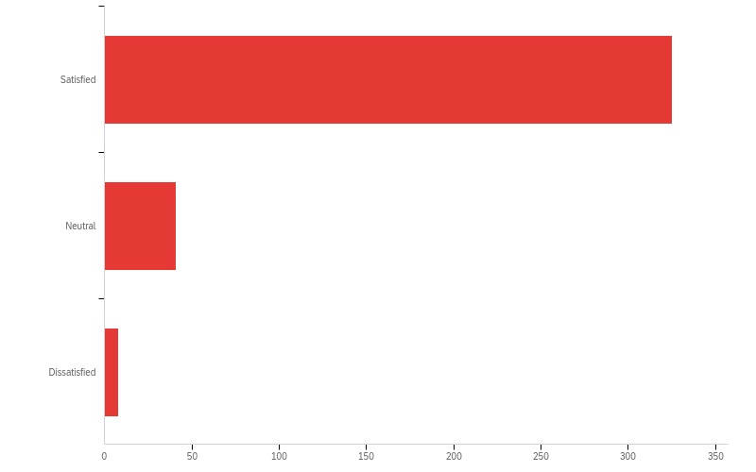
Q18 - Are you happy with your post-retirement experience?

Slide 165
Q18 - Are you happy with your post-retirement experience?
# | Field | Minimum | Maximum | Mean | Std Deviation | Variance | Count
1 | Are you happy with your post-retirement experience? | 1.00 | 3.00 | 1.15 | 0.41 | 0.17 | 374

Slide 166
Q18 - Are you happy with your post-retirement experience?
# | Answer | % | Count
1 | Satisfied | 86.90% | 325
2 | Neutral | 10.96% | 41
3 | Dissatisfied | 2.14% | 8
 | Total | 100% | 374

Slide 167
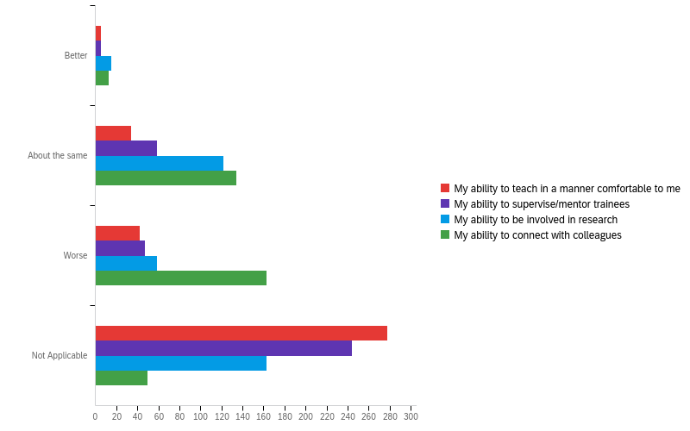
Q23 - Compared to pre-pandemic times, how much has the following changed for you in the last year?

Slide 168
Q23 - Compared to pre-pandemic times, how much has the following changed for you in the last year?
# | Field | Minimum | Maximum | Mean | Std Deviation | Variance | Count
1 | My ability to teach in a manner comfortable to me | 1.00 | 6.00 | 5.20 | 1.51 | 2.28 | 359
2 | My ability to supervise/mentor trainees | 1.00 | 6.00 | 4.87 | 1.71 | 2.92 | 355
3 | My ability to be involved in research | 1.00 | 6.00 | 3.94 | 1.93 | 3.71 | 359
4 | My ability to connect with colleagues | 1.00 | 6.00 | 2.97 | 1.33 | 1.77 | 360

Slide 169
Q23 - Compared to pre-pandemic times, how much has the following changed for you in the last year?
# | Question | Better |  | About the same |  | Worse |  | Not Applicable |  | Total
1 | My ability to teach in a manner comfortable to me | 1.39% | 5 | 9.47% | 34 | 11.70% | 42 | 77.44% | 278 | 359
2 | My ability to supervise/mentor trainees | 1.41% | 5 | 16.62% | 59 | 13.24% | 47 | 68.73% | 244 | 355
3 | My ability to be involved in research | 4.18% | 15 | 33.98% | 122 | 16.43% | 59 | 45.40% | 163 | 359
4 | My ability to connect with colleagues | 3.61% | 13 | 37.22% | 134 | 45.28% | 163 | 13.89% | 50 | 360

Slide 170
Q24 - Any final comments?
Any final comments?
since I live in Victoria most campus activities are not relevant - I continue to be active in research and writing and in contact with First Nations communities
Never forget that even after retirement your advice and experience are caluable assets of UBC.
As you see above, opportunities for collegiality among emeriti rank highest in my needs over the retirement years. A mini-faculty club for emeriti is the Ideal... Or anything moving in that direction! Note emphasis on coffee... and congenial events (the talks held intermittently at Tapestry in some past years were a splendid example, but all too rare...) I assume that ubc lectures & similar events will resume in due course: Vanc. Inst. type things were precious but rare. Please be in touch with me on these matters! p. merivale
keep up the good work you do.
Let's all stay young, without its mistakes.
Very happy with the Emeritus College. I am now in my 80s and finding less interest in most of the activities but would like to keep in touch.
For the past 18 years I have lived and worked at universities mainly in Thailand - but also India and Indonesia. It continues to be a rewarding life, academically - as well as living in the tropics. Always happy to keep in touch with UBC - a great institution.

Slide 171
Q24 - Any final comments?
Any final comments?
Thank you for the opportunity.
none at this time
I was not very aware of what kinds of events I could take advantage of and might enjoy. I would like to be able to join some by Zoom to increase my likelihood of connecting and finding some events I might have been a bit hesitant to come in person. I wrote a number of online courses before others began and I could have been helpful when many courses had to go online. I would have stepped forward but UBC just changed their choice of delivery company. I think it would have been helpful for me to meet with the Department Head to find out what they would have liked to involve me in.
My husband passed away suddenly last September, and so the social isolation due to COVID has hit me hard. I am now interested in joining some groups so that I have opportunities for social interaction with other emeriti.
Overall the College is doing a grand job and more power to the movers and shakers behind
I look forward to attending again in person meetings of professors emeriti.
the speaker series is excellent. Just terrific range of topics and very high quality presentations.

Slide 172
Q24 - Any final comments?
Any final comments?
None
Keep up the good work And I may have done the survey twice-sorry
Congratulations on getting us through the worst of the epidemic College might provide more advice on Downsizing Mental health
I have come to appreciate that as a UBC Professor Emeritus I have amazing opportunities to contribute to society through retirement which is very satisfying.
n/a
nothing. A good survey./ questionnaire
I am a recent retiree and I am working full time in another job so I have not have had the time to explore and enjoy the Emeritus College fully yet. Look forward to more interaction in the years to come.
I would appreciate a clearer articulation of the purposes and intent of the Emeritus College compared to the previous association. What formal role, if any, does it have in the overall governance model of UBC?

Slide 173
Q24 - Any final comments?
Any final comments?
I appreciate the work being done by the Emeritus College and look forward to post-pandemic initiatives.
I live on Vancouver Island so even in non-pandemic times it was difficult to attend in person
Thanx for taking the effort to send this survey
It would be nice to know how many members live outside of Vancouver and, if there are other members like me, acknowledge that the Emeritus College is indeed a distributed Provincial institution, very much like UBC is at present. As I mentioned in a comment above, I reside in Victoria, BC and worked in the island Medical Program, a distributed regional campus of the UBC Faculty of Medicine.
Thank you for your interest.
No
Would be interested in spearheading an outreach program that would see school children from neighbourhoods where a minority of parents are college educated interacting with the Emeritus College/emeriti as a way of exposing them to the idea of University. Niamh Kelly niamh.kelly@ubc.ca

Slide 174
Q24 - Any final comments?
Any final comments?
Keep up the good work. Keeping connected is vital.
Alerts to our age group such as the announcement to re-register for 2nd vaccination was appreciated.
Thank you for the important role that the EC plays in our lives and i the UBC community.
I can be contacted regarding the issues noted earlier regarding banking arrangements for estates if there is interest in following up with me. Kellogg Booth ksbooth@cs.ubc.ca
I'm enjoying retirement. I no longer do the long commute to UBC but now lecture to local growths, particularly youth.
The assumption underpinning this survey appears to be that all Emeriti are located in or close to the UBC campuses. I live abroad. I therefore welcome being able to access College resources and events online and it is has been a pleasure, during the COVID pandemic, to see on Zoom (mostly) past colleagues. Thank you
Emeritus College is doing a great job in developing innovative ways to connect people and meet their interests. Thanks you so much!
No

Slide 175
Q24 - Any final comments?
Any final comments?
I might have already filled this out...!!
Retain the strong framework of academic interest alongside more informal community.
Thank you for supporting professors emeriti. Stay safe..
No.
Thank you for your work supporting Emeriti
I miss the UBC atmosphere, being on the wonderful campus and interacting with students and faculty. I am fortunate that four of the researchers in my lab joined my company and I have almost daily interaction with them. Conducting research has been an important part of my entire life and I am privileged that I can do so in retirement. I now live on Vancouver Island and it not easy to travel to Vancouver with Covid19 around. Hopefully that will be over soon. I have many contacts with leading wineries around the world and I am willing to organize tours for emeriti.
Although I’m not currently participating on College activities, it’s good to know that this option exists. I appreciate knowing that there are opportunities for future involvement with a range of people who have worked in this particular type of environment.

Slide 176
Q24 - Any final comments?
Any final comments?
Our department now has another new chair, and when Covid dangers subside, I am hoping to talk with them about possible support for the small percentage of my research project which remains.Basically I continue to need printing from the library and access to the library computer's SPSS program. Basically, I propose adding the option of an "emeritus pay-for-print card (like students have) to enable printing and the use of some research programs (such as SPSS for doing statistics, and the other programs which my qualitative-research colleagues require). Thanks to your financial support for emeriti researchers, I was able to present a paper from my research to the American Sociological Association Annual Meeting in 2019. Thank you for all you do, and for listening to my comments about what may make your help even better.
Covid has played havoc with my relationship with the campus and most of my colleagues. I am still involved in 2 dissertations as supervisor. Before Christmas I worked very hard with a third student who is losing her sight, which required extra work, although I was not the director. The person who replaced me is not allowed to direct dissertations as an Assistant Professor, if I understand correctly. I think that it would be nice if the Department and/or the Faculty thanked or ackowledged people such as myself. Perhaps a gift certificate from the bookstore too? We are helping the University, but receive no compensation or recognition.
The Emeritus College does a great job in providing programmes for, and connecting retired people.

Slide 177
Q24 - Any final comments?
Any final comments?
Thanks for conducting this survey.
You are doing a good job. I retired from UBC in 2001, but continued teaching and research at two other universities, in Hong Kong and Taiwan, So, in effect, my active career continued for several years after that. I published my last book in 2009 with EJ Brill; it was based on extensive fieldwork in rural north China, c2002-2008 So, my teaching and research career continued until 2009.
As I am ninety years old and just surviving has become a full time job ! I enjoy reading about all the programs that are active even without participating, Thank you for asking. The long questionnaire is exactly what a research project should be, and I hope us older folks will take the time to ponder each question and answer them, perhaps not in the time suggested.
The pandemic has made me feel more isolated, and I look forward to its ending. I used to enjoy the talks sponsored by the emeriti and the teas that preceded them. The teas allowed casual chats with former colleagues and other emeriti that I hadn't known while active at UBC.
I have found retirement to be a most wonderful experience. Doing creative work -- writing fiction and publishing it -- has provided me with new perspectives and great opportunities to exercise my imagination in new ways. To be honest, it's been totally exhilarating.

Slide 178
Q24 - Any final comments?
Any final comments?
Let's just get through these pandemic restrictions first and try to figure out a 'new normal'...
Thanks for asking!
Thank you
I have not been very engaged with the Emeritus College yet - too busy. But I look forward to becoming more involved in the future. From what I have seen it seems to be an excellent organization!
The provision of modest research support was a most wonderful development. I hope it can continue. I expect the current system to grow and develop as it has over the last 20 years.
I now live in Langley. Having a formal way to interact with local institutions would be helpful. UBC is just too far away to allow in person visits.
We should make sure that all emeriti are made aware of the College, and shown how its many activities can enrich their experience.
The Emeritus College seems to be less independent of UBC administration than was The Association of Professors Emeriti. (Consider, for example, Johnson Insurance promoted via APE.) I regret this change.

Slide 179
Q24 - Any final comments?
Any final comments?
The Emeritus College has been a very positive factor in my transition to retirement. Thank you to the UBC administration and to the EC Council and staff for the support that is offered.
Very pleased to be a member of the Emeritus College. I didn't realize how important it would be in my retirement experience. I think COVID has increased this importance to stay connected to people outside my immediate realm. I do miss visiting the campus and taking part in events/activities in person!!
Thank you for conducting this survey, I hope you receive valuable information.
I found some of the questions hard to provide a single answer to, because of the lenght of time since I retired.
Thanks for asking!!
I participated in an art slide show accompanying a recent panel on profs-who-do-art and tried to find it later but couldn't. Is that slide show available on the website? Thanks.
The College is doing very well under the unexpected and unfamiliar circumstances. I appreciate your commitment to a common good.

Slide 180
Q24 - Any final comments?
Any final comments?
Thanks
Keep up the good work!
NO
No.
So far in my retirement I have been very busy with continued UBC research, some consulting, intense involvement in community based activities and working on my own projects (Building an airplane). I look forward very much to participating in Emeritus College activities- they sound very interesting! From what little information I have, the Emeritus College is doing a great job!
Thanks for offering this opportunity to voice an opinion.
I welcome the contribution the Emeritus College has made to keeping us "retired" faculty involved with the university.
Thanks so much to the people who have put so much effort in to the survey.
Many of my answers relate to the fact that I am now almost 92 yrs. and no longer able to participate in many/most activities which were previously of interest.

Slide 181
Q24 - Any final comments?
Any final comments?
Somehow I never got involved with APE when I first retired and so never found a connection to the group. During my working years time didn’t allow much social interaction with other faculty so upon retirement I didn’t have social connections to other faculty so my retirement path has had very little connection to other retired members.
Thank you for this carefully designed and in-depth survey. Please share the results when available.
I have been retired almost six years. My first five years were quite active in terms of research, publishing, reviewing, some conference participation, etc. I did appreciate the subsidy program to support my research. Over the past year, I have drawn away from many of these activities. But I know colleagues who are still very active and will appreciate all of that sort of support. In my faculty, due to space concerns, the shared office space that I have had is diminishing and in fact I will move out this summer (personal choice). For some that may be difficult.
I am looking forward to visiting the new building as I never had a chance to take a tour.
Thanks for all the efforts of the people who help move the emeritus college forward. Great work on the behalf of others is being done by these folks.

Slide 182
Q24 - Any final comments?
Any final comments?
With regard to the question about my preference to participate in College meetings and events...although I selected continue all online per the pandemic I would participate in some events face to face if available. I didn't select that option because it may not be possible for all current and future events to continue to be available online. Although I recognize many of the names and faces among college members, and know and have worked with a number of members, face to face may increase opportunities to get to know members in different ways. I've designed courses, taught and worked online for over 20 years so that is not the reason for my comment. Thank you for inviting feedback from members!
For early retirees, the Emeritus College looks a bit like Tapestry. The College should be more like a college with active participation in teaching and learning open to people over 60. Not just members of the college. Collaboration with Extended Learning could help. UBC had an thriving senior community in the old days, bringing together academics and local seniors. It can be self sustaining. This would fit the inclusive mandate of the university. Seniors are not seniors anymore unless they are in their eighties or nineties.
Thank you for this opportunity!
I have enjoyed the efforts on our behalf.
It takes time, but I think efforts need to be made to increase the visibility of the Emeritus College within departments and the university as a whole. The College is the voice for retired colleagues and all that they have to offer but also the experience in supporting people with their planning and transition to retirement. Hugely impressed with how the Emeritus College has taken flight and expanded its offerings. I am also relieved that it is a home for those with divergent interests and is not focused predominantly on colleagues who continue to pursue research endeavours. It is a great model for other academic institutions across the province, nationally and even internationally. Well done!

Slide 183
Q24 - Any final comments?
Any final comments?
My sense of UBC emeriti is that there are generational differences as well as differences in relation to gender and race. The diversity of UBC retirees means that programming and services need to be flexible. And there seems to be a shift towards more bureaucratization as the College becomes more established. Some formalizing of roles and responsibilities is needed but it would be great if the College didn't organize itself in a hierarchical manner.
I appreciate that the College is there
Thanks for the opportunity to participate in the survey. Would have been good to ask the kind of information that would yield metrics useful for stressing the contribution of the college to UBC. This was the time to do it.
I appreciate the College and I think that by being a member of the college it has made a difference in my transition to retirement. The Subsidy supports definitely made a difference in my international participation in conferences. Thanks so much.
The activity of the college and its offerings need to be amped up. Improve the possibilities for engagement and social interactions among the retirees
I am pleased that the College now exists and is actively seeking ways to engage the retired colleagues who, having devoted their lives to academic pursuits, have not developed any interests beyond academe. I find it worrying to hear the wives of many retired colleagues describe their husbands’ daily lives which seem to me to indicate that these men are depressed, having “lost” their purpose in life, and hence their sense of identity. Very sad.

Slide 184
Q24 - Any final comments?
Any final comments?
To those of us in the Okanagan, this group is very Vancouver-centric.
Would have liked to have the opportunity to expand on some of my choices, with a comment box underneath the multiple choice questions.
i really miss in-person meetings, but i also realize that many of us aren't in Vancouver or find it difficult to come out to UBC. I'm not sure what the right balance is, but I think we need to maintain some activities on Zoom.
Thanks for being there. I hope to participate in more events after the pandemic has eased.
I continue to work in journal editing I am also much involved in disciplinary history, prepare history of Botany and Botanical sciences at UBC I also volunteer with the Music school.
No
The culture of UBC has changed significantly since I retired, a relatively short time. Its wholehearted adoption of Progressive Puritanism along with cancel culture and a faith based, rather than a true scientific approach to much of the research and teaching saddens and alienates me.

Slide 185
Q24 - Any final comments?
Any final comments?
As a new member, I am looking forward to being involved with activities of the College
Support from UBC for my research/writing activities has been excellent.
good survey!
As a relative newcomer-comer to the College, I do my have a lot of experience to draw on, but I’m happy to share my experience whenever appropriate.
College is doing well and will continue to evolve.
You are doing great. I spent a lot of time preparing for retirement, so i don't feel I need much support. Others may have greater needs though. I am very happy with retirement.
I value the College and hope for the resumption of in-person gatherings, especially academic events.
Very appreciative of the support of the college. I'm not very involved at this point. I'm not a typical emerita in that I only taught for 13 years, was hired at 51, and am a professional, not an academic. So the community isn't that much of a match for me, but it is nonetheless vital and welcoming. Very much thankful for all the fine work being done.

Slide 186
Q24 - Any final comments?
Any final comments?
In the course of the 28 years of retirement, my connections with UBC (including the emeriti assocation/college) has diminished.
I value the work done by EC volunteers
nope. My experience was/is probably not very useful to draw lessons from. Seems to me like you should remember that most faculty are not ones winning awards. They are simple "good enough".
Thanks for the opportunity to answer
No - thanks for doing this.
Long events are tough by zoom, but short events are better by zoom because it doesn’t require travel time disproportionate to event time
The College and its predecessor have provided a great environment for me.
I would like to see links to other university programs for retired faculty. I have a number of European colleagues engaged in similar Emeritus associations and our "visiting" through internet and with possible mutually beneficial events - amusing as well as informative.

Slide 187
Q24 - Any final comments?
Any final comments?
Though located far from UBC (unfortunately), I greatly value the College and would love to have more access to some events through recordings, if this is feasible for staff. There is a 17-19 hr time difference between the campus and my location so live Zoom links don't actually help.
I really like the idea of the emeritus college. It is too bad that the pandemic has caused such turmoil. I am not negative – I just feel a bit restricted
Without zoom and the internet it would be difficult to keep my research life going. On the other hand there is my library.
I have reconnected with some former colleagues because of zoom
Good survey
Thanks for designing and conducting this survey, and my very best wishes to the Executive and staff as the current academic years draws to a close and plans for the coming session take shape. On reflection, my experience of retirement was tremendously enhanced by two things: my early engagement in non-academic volunteer activities, and my ability to take advantage of one of the Retirement Options designed by the FA for the University. Hence my earlier suggestion that both of these elements might be worthwhile for the College to consider programmatically if there appears to wider support.

Slide 188
Q24 - Any final comments?
Any final comments?
I think the College is doing an excellent job of keeping Emeriti/ae abreast of what is happening on campus. Although it has some wonderful interest groups for changes in intellectual stimuli, I would like to see the College looking at both future directions of Universities (career prep or liberal education) and even the educational system (does everyone need a University Education?). Is there a better model, and to this end I would like to hear from experts on other systems used throughout the world. I think we are very insular and protective of our system. Just a thought.
I am very happy to be a member of Emeritus College and look forward to the events and meetings. I will be happy when there is a return to in person meetings once they can be undertaken. However, since I live in North Vancouver, I also appreciate being able to "attend" without the long drive. Many thanks to Graeme Wynn for his leadership and inspiring reports - they were part of my enjoyment of the newsletter.
Thank you for all of your work, it is very much appreciated!!
My name is Barbara Williamson. I am the widow of John Edward Michael Kew (J.E. Michael ...). My husband died Nov. 22, 2020 and I am taking this opportunity to announce his death to the College. I suggest you might do more to facilitate notifications of death by family or colleagues, and to announce deaths of members. For the foreseeable future I will use the Email address: willkew@shaw.ca. Dr. Kew's last illness prevented him from participating in the College's benefits to retirees.

Slide 189
Q24 - Any final comments?
Any final comments?
I look forward to meeting my emeritus colleagues in the flesh!
Great and valuable organization
My gratitude to all who contribute to the work of the College
It is a gift to have the Emeritus College.
I knew that some bridges would crumble when I retired in 2018 but CoVid has created a terrible double-down knockout in this respect. I feel isolated and miss the stimulation that comes with live interactions.
After retirement I went back to school and got a Diploma in Textile Art which has occupied much of my time since in various capacities from teaching to administration.
For faculty who have retired outside of Vancouver, the ability to join by Zoom or a webinar to Emeritus events is really important in helping someone to stay, and feel, connected. But I also appreciate the potential opportunity to see each other in person. My favorite event ever was the two day ‘conference’ (2018or19?) with lots of speakers on different subjects, and an address at the end by Santa Ono. Great information, great socializing, great connection to the University.

Slide 190
Q24 - Any final comments?
Any final comments?
The Emeriti Association now College has been and important source of retirement education and an opportunity to maintain contact with UBC colleagues.
Kudos to the new newsletter editor, Margery Fee, who is doing a wonderful job -- like her predecessor!
Extended sickness over the past three months has substantially altered my view of the world.
Not a well conceived questionnaire, but they never are.
I feel happier and more fulfilled in semi-retirement than I was when working full-time!
I find I am tired of the university world and am pursuing non-academic activities (fiction writing, language learning, travel). I do not anticipate attending any UBC activities again.

